Slide 1



November
New Directors’ Webinar
Loria Hunter, Education Specialist II
ALSDE Child Nutrition Programs
New Directors’ Training
November 2023

Slide 2
Webex Recording
Click here to access the Webex recording
Notes:
Read slide.

Slide 3

Learning Code
Event Name: New Directors’ Webinar
Event Date: November 2023
Length of Time: 20 minutes
Professional Learning Code: 3200
ALSDE Child Nutrition Programs

Slide 4

Agenda
Monthly Checklist
Verification – completed by Nov 15th
Verification Summary Sheet due Jan 20, 2024
Verification Instructions attached to email
Local Wellness Plan

Slide 5
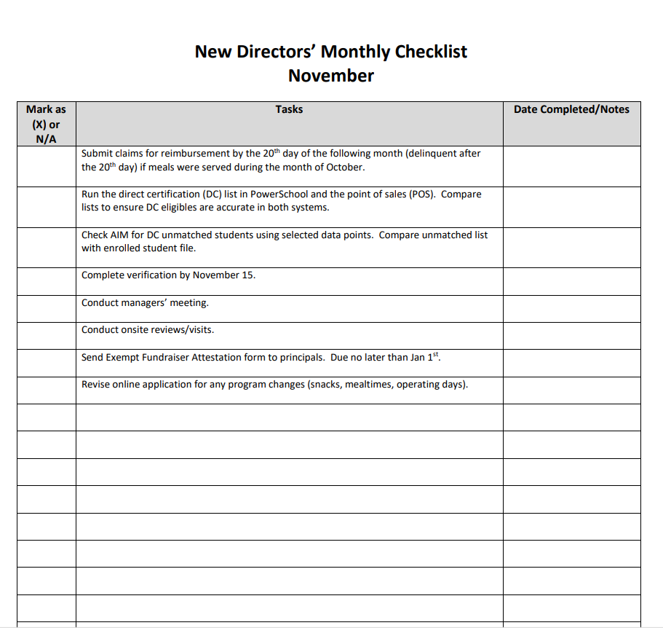

Monthly Checklist

Slide 6
Purpose of a Local Wellness Policy
To establish a school environment that promotes
students’ health, well-being, and ability to learn
Notes:
Read slide.

Slide 7

Local Wellness Policy
REGULATIONS
2004 Child Nutrition WIC Reauthorization Act required all district to establish Local wellness policies by SY 2006-2007
2010 Healthy, Hunger-Free Kids Act requires
every LEA participating in the NSLP/SBP to
have a written wellness policy.
2016 USDA Final Rule: All LEAs required to
develop a revised wellness policy
Notes:
Local educational agencies (LEA) participating in the National School Lunch Program and/or School Breakfast Program are required to develop a local school wellness policy that promotes the health of students and addresses the problem of childhood obesity. This includes charter schools, religious schools, private schools and RCCIs.
2004 Requirements directed LEAs to have a LWP in place for each school under its jurisdiction.
2010 requirements strengthened LWPs and added requirements for public participation, transparency, and implementation.
2016 final rule finalized regulations to create a framework and guidelines for written wellness policies. It mandated that the revised policy had to have been in place by the end of SY 16-17.

Slide 8
School Wellness: It’s Everybody’s Job!
Stakeholder Involvement
Parents
Students
SFA representative
School Board Member
School Administrators
PE teachers
School Nurses
Community Leader
Stakeholder Participation
Development
Implementation
Periodic review and Update
Notes:
In an effort to foster transparency and inclusion, LEAs are required to allow parents, students, SFA representatives, teachers of physical education, school health professionals, the school board, school administrators, and members of the general public to participate in the development, implementation, and periodic review and update of the local school wellness policy.

Slide 9
School Wellness: It’s Everybody’s Job!
School Wellness Committee
Responsible for updating and implementing
the local wellness policy
Stakeholder input
Establish frequency of committee meetings
Keep minutes, agenda, and sign in sheets
Notes:
It is important to document committee meetings and outreach to committee members. All documentation will be used to ensure Federal and local requirements are being met. The wellness committee should work together to figure out how well the wellness plan is being implemented as well as how the triennial assessment should be conducted. Keep copies of the committee minutes, agenda, and sign in sheets.

Slide 10
School Wellness: It’s Everybody’s Job
Wellness Committee Lead Chairperson
Regulations do not specify title or position
LEAs discretion – to designate a responsible official
Acts as liaison between committee and superintendent or program administrator
Notes:
Read slide.
The Wellness Lead should keep the superintendent/administrator informed of meetings and updates to policy. The lead should provide superintendent a copy of policies developed (if new) and goals and objectives for the coming year.

Slide 11
Wellness Committee Planning
Meetings can be held virtually or in person
Survey parents, teachers, administrators to determine
what works best
At the beginning of the school year, determine number
of meetings along with dates and times to meet.
Review current local wellness policy
Set a goal.
Is it outdated?
Has it been assessed in the past three years?
Does it contain the required components?

Slide 12
Local Wellness Policy Minimum Requirement
Nutrition Education and Promotion
Physical Activity
Standards and Nutrition Guidelines for Foods and Beverages
Food and Beverage Marketing/Advertising
Public Involvement
Triennial Assessment
Update or modify the local school wellness policy as appropriate
Notes:
A local school wellness policy is a written document that guides a LEA in establishing a healthy school environment. While LEAs have flexibility to develop the specific content of their local school wellness policies, the policies must include the following: • Specific goals for nutrition promotion and education, physical activity, and other school-based activities that are designed to promote student wellness • Standards and nutrition guidelines for all foods and beverages available on the school campus during the school day that are, at a minimum, consistent with Federal regulations for program meals and the Smart Snacks in School nutrition standards, and designed to promote student health and reduce childhood obesity and; • Policies that allow marketing or advertising of only those foods and beverages that may be sold on the school campus during the school day, i.e., those foods and beverages that meet the Smart Snacks in School nutrition standards.
LEAs are also required to: • Review and consider evidence-based strategies in determining local school wellness goals • Involve, inform, and update the public (including parents, students, and other stakeholders) about the content and implementation of the local school wellness policy and; • Conduct an assessment, at least once every three years, to determine compliance, progress, and the extent to which the policy compares to model local school wellness policies and • Update or modify the local school wellness policy as appropriate.

Slide 13
Local Wellness Policy Assessment
The wellness policy must be assessed every three years
Measure compliance with Federal and State regulations
Compare policy to model policies (A list of suggested tools
are on the following slide.)
Progress made meeting goals of policy
Report must be made available to the public
Notes:
At a minimum, assessments must be conducted once every three years ; this is referred to as the triennial assessment. The LEA must develop a triennial assessment report that describes the extent to which its schools comply with the local school wellness policy, the extent to which the local policy aligns with model policies, and a description of progress towards attaining policy goals. There is local discretion on the format of the report. This report must be made available to the public. You will be able to generate a report from the online tools listed on the following slide. You may also use the triennial assessment report template on the Alabama Achieves website to document the result of the assessment.

Slide 14
Triennial Assessment Tools
WellSat 3.0
www.wellsat.org
Alliance for a Healthier Generation
www.healthiergeneration.org
Centers for Disease Control School Health Index
https://www.cdc.gov/healthyschools/shi/index.htm
LEA specified tool
Notes:
Here is a list of the recommended assessment tools. You may choose to use one of these or develop one specific to your district.

Slide 15
Local Wellness Policy Assessment
Review the local wellness policy requirements
(See checklist Alabamaachieves.org>Community>Child Nutrition Programs>
School Nutrition>Local Wellness Policy>Local Wellness
Policy Checklist)
Review Alabama Implementation of USDA Smart Snacks in
School and Fundraising Activities (See Alabamaachieves.org>
Community>Child Nutrition Programs>School Nutrition>Smart Snack
Standards>Smart Snack and Fundraiser Guidance and
Implementation)
LEAs may have stricter standards than the Federal standards
Notes:
ALSDE has provided you with some resources to assist in following the wellness plan guidance. There is a wellness plan check list, Smart Snack guidance, and as mentioned on the previous slide a triennial assessment report template. Remember your wellness policy may be stricter than the Federal standards but not less restrictive.

Slide 16
Assessing the Wellness Policy
Compare local wellness policy to model policy
Complete the selected assessment tool
Assess compliance in policy and practice with
state/federal requirements
Document progress toward goals
Identify connections between policy and practice
Share assessment with public and during AR
Summarize and Share Finding
Notes:
You have the flexibility to develop tools that will assess compliance with the specific components of your policy. The online assessment tools require that you create an account and complete the assessment by answering a series of questions related to the minimum elements that must be included in the plan e.g. nutrition education and promotion, physical fitness, etc.. A good assessment tool will help evaluate the local wellness policy and access the quality of the policy. It will also provide feedback and resources to self monitor progress meeting the wellness policy goals. I recommend reading the survey items first then read the wellness policy. This will help you hone on the items you need to look for while answering survey questions. Be mindful the wellness assessment process will take some time. You will need to interview personnel best suited to answer each section e.g. cnp director, head of curriculum, health/nutrition teacher, principal, PE teacher, classroom teacher. By distributing survey questions to the right personnel, it will help ensure accurate representation of what’s happening in the district. This information will need to be collected for the completion of the assessment tool.
Once the assessment is complete you will be able to determine where the policy aligns, doesn’t align or needs room for improvement. You will create a summary based on the strengths and weaknesses resulting from the assessment. Notate if the district is doing well in policy and practice. Include steps for updating the policy for items that need improvement. The triennial assessment and wellness plan must be posted for the public to access. Make sure if you revise your wellness policy that it is approved by your governing board.

Slide 17
Covid 19 Triennial Assessment Waiver
Based on July 1, 2017, implementation of local
school wellness policy, the first triennial assessment
should have been conducted by June 30, 2020.
Due to the covid-19 pandemic, the triennial
assessment date was changed to June 30, 2023.

Slide 18
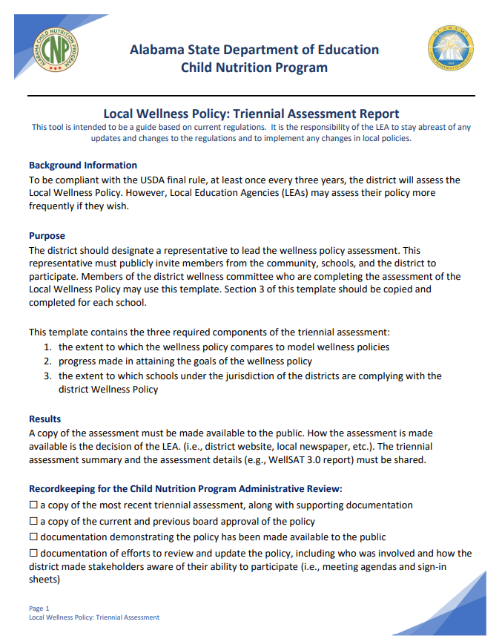
ALSDE Local Wellness Policy Triennial Assessment Report
Use to organize and collect
information.
Keep on file for AR.
Maintain supporting
information from triennial
Assessments with this template
Go Alabamaachieves.org

Slide 19
Local Wellness Policy and Administrative Review
To prepare for the Administrative Review, LEAs must:
Provide a copy of appropriate web address of the current wellness policy
Provide documentation to confirm the policy was made available to the public
Provide documentation that outlines when and how the review and update
of the policy was conducted
Provide documentation of how potential stakeholders were made aware
of the opportunity to participate in the development, review, update and
implementation of the plan
Provide documentation on assessment of the policy and how the public is made aware of the assessment results

Slide 20
Summary
Determine when your triennial assessment is due.
Review the current school wellness policy.
Contact committee members.
Recruit new members, if necessary.
Schedule wellness meeting.
Review online wellness assessment tool.
Assign portions of the tool to committee members.
Collect and collate survey information.
Meet with committee to review assessment and develop assessment summary.
Revise wellness plan, if necessary.
Submit for board approval.
Post assessment and wellness plan for public access.
Maintain committee minutes, sign in sheet, agenda, and supporting assessment documentation.
Notes:
Read slide.

Slide 21
Resources
Smart-Snack-and-Fundraiser-Guidance-and-Implementation.pdf (alabamaachieves.org)
ALSDE-Local-Wellness-Policy-Checklist.pdf (alabamaachieves.org)
CNP_2021525_Local-Wellness-Policy-Triennial-Assessment-Report-Template_
V1.0.pdf (alabamaachieves.org)
USDA Resources
https://www.fns.usda.gov/tn/local-school-wellness-policy
https://theicn.org/icn-resources-a-z/sustaining-and-strengthening-local-
wellness-initiatives/
Assessment Tools:
WellSAT: Rudd Center — Home
Alliance for a Healthier Generation
CDC Healthy Schools Assessment

Slide 22


Email:
cnpnslp@alsde.edu
loria.hunter@alsde.edu
Subject Line: New Director November Webinar Question
Remember: Questions and answers will be compiled and shared via email.

Slide 23

USDA Non-Discrimination Statement
In accordance with federal civil rights law and U.S. Department of Agriculture (USDA) civil rights regulations and policies, this institution is prohibited from discriminating on the basis of race, color, national origin, sex (including gender identity* and sexual orientation*), disability, age, or reprisal or retaliation for prior civil rights activity.
Program information may be made available in languages other than English. Persons with disabilities who require alternative means of communication to obtain program information (e.g., Braille, large print, audiotape, American Sign Language), should contact the responsible state or local agency that administers the program or USDA’s TARGET Center at (202) 720-2600 (voice and TTY) or contact USDA through the Federal Relay Service at (800) 877-8339.
To file a program discrimination complaint, a Complainant should complete a Form AD-3027, USDA Program Discrimination Complaint Form which can be obtained online at: USDA Program Discrimination Complaint Form, from any USDA office, by calling (866) 632-9992, or by writing a letter addressed to USDA. The letter must contain the complainant’s name, address, telephone number, and a written description of the alleged discriminatory action in sufficient detail to inform the Assistant Secretary for Civil Rights (ASCR) about the nature and date of an alleged civil rights violation. The completed AD-3027 form or letter must be submitted to USDA by:
(1) mail: U.S. Department of Agriculture
Office of the Assistant Secretary for Civil Rights
1400 Independence Avenue, SW
Washington, D.C. 20250-9410; or
(2) fax: (202) 690-7442; or
(3) email: program.intake@usda.gov.
This institution is an equal opportunity provider.
*The enclosed “non-discrimination” language herein was added pursuant to the May 5, 2022, USDA memorandum. However, although included as currently required for audit compliance by the USDA, the State of Alabama objects to its inclusion, applicability and the application of this language due to currently pending legal challenges in the matter of The STATE OF TENNESSEE, ET AL. V. USDA, ET AL., Case No. 3:22-cv-00257, and may be subject to change or removal.
Alabama State Department of Education

