Slide 1
Welcome!
Cartewheel Meal Counter
SFSP Training
Alabama SFSP Sponsors
LINQ Staff
ALSDE Employees

Slide 2
Questions:
What is the Cartewheel Meal Counter?
Who must use this program?
Why do I need this?
How will it help my SFSP program?
What if I have issues?
Who do I contact?
Have I downloaded the app?
When do I need to get started?
Where do I store my records?

Slide 3
Questions:
Will the app be used for both open and closed sites?
What if the meal counter is completed late due to technical issues with devices, service outages, or unforeseen circumstances? Who should the site supervisor contact to relay this message?
How long does the password reset take?
How are revisions made if an error is found?
Can revisions be made on the administrative side?
Do daily forms/tally sheets need to be printed monthly?

Slide 4

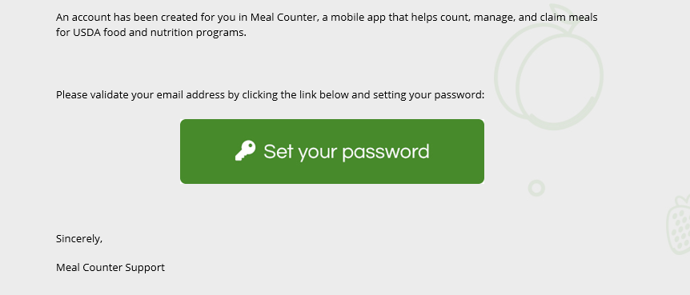
*If you did not receive this email from Meal Counter Support, please contact your Education Specialist at ALSDE.

Slide 5

Make sure you insert the correct web address to access the meal counter application to begin your set-up.
Installation

Slide 6
-All SFSP sponsors have been entered into the Meal Counter System. Your Education Specialist was tasked with setting up the Sponsor User account.
-A few school systems have contacted our office to inform us that they haven’t received the notification. Please contact your IT department to determine if a firewall is preventing the email from transferring into your inbox.

Slide 7
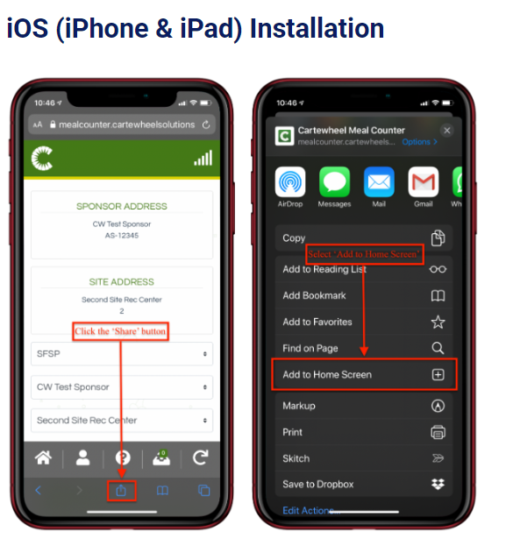
Download Instructions

Slide 8
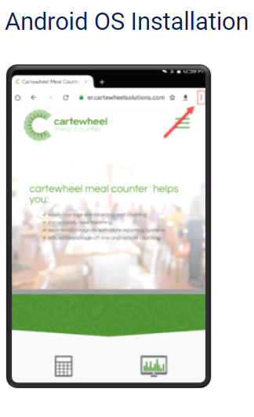
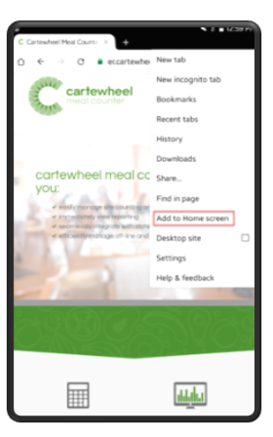
Download Instructions

Slide 9
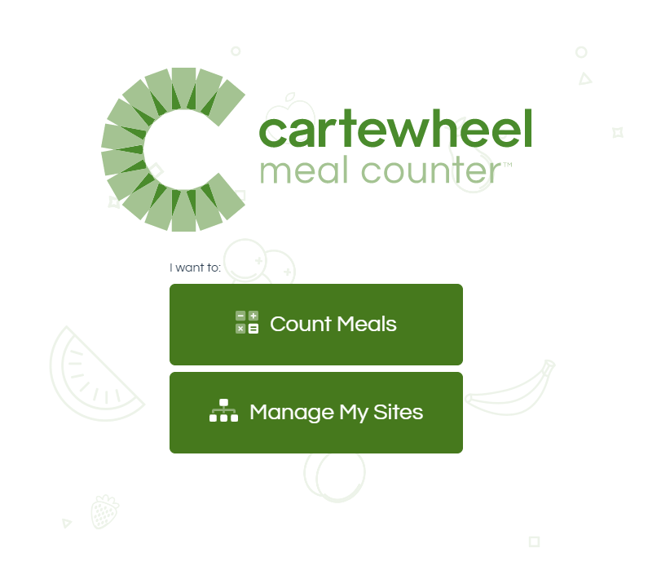
This page will lead you to your login screen for Sponsors.

Slide 10
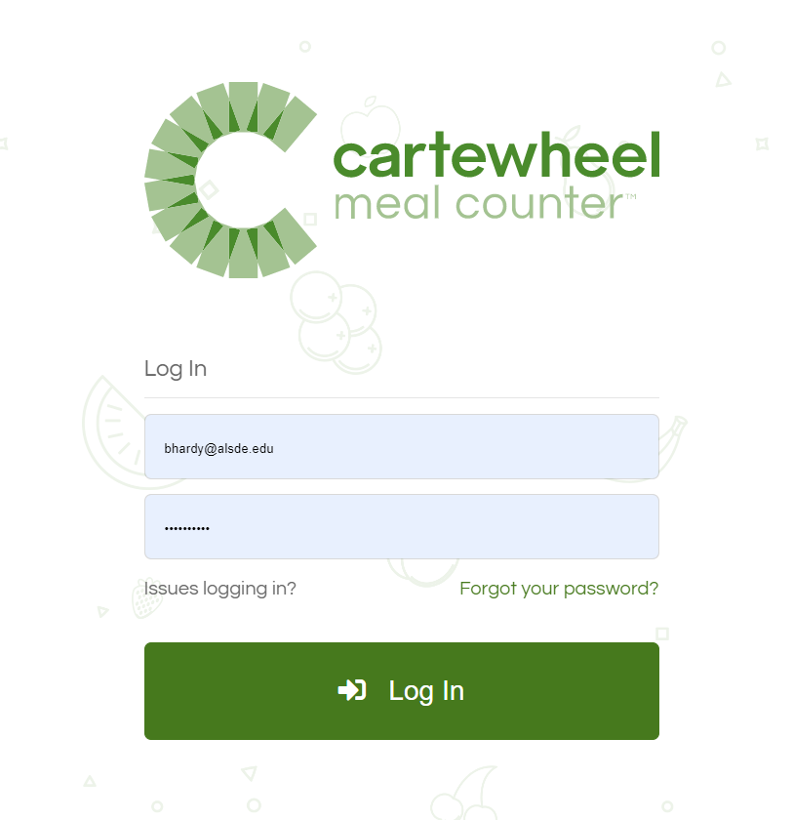
-This is the next screen that should be on display. You will be prompted to set your password.
-If you did not receive the notification from Meal Counter Support, click on “Forgot Your Password” to see if another notification will be delivered to your email address.

Slide 11

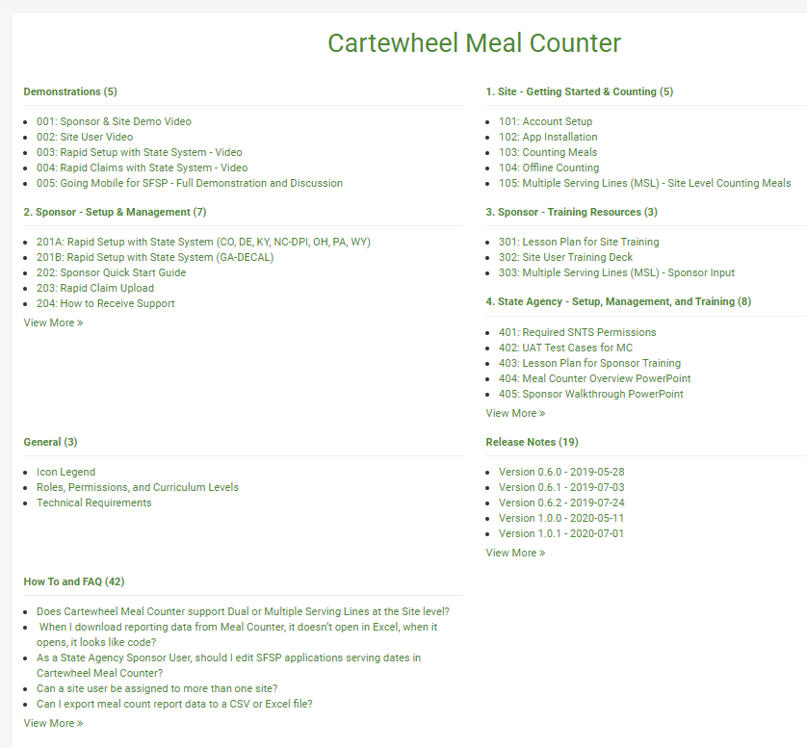
Knowledge
Base
iLearn
database
at your
fingertips!

Slide 12
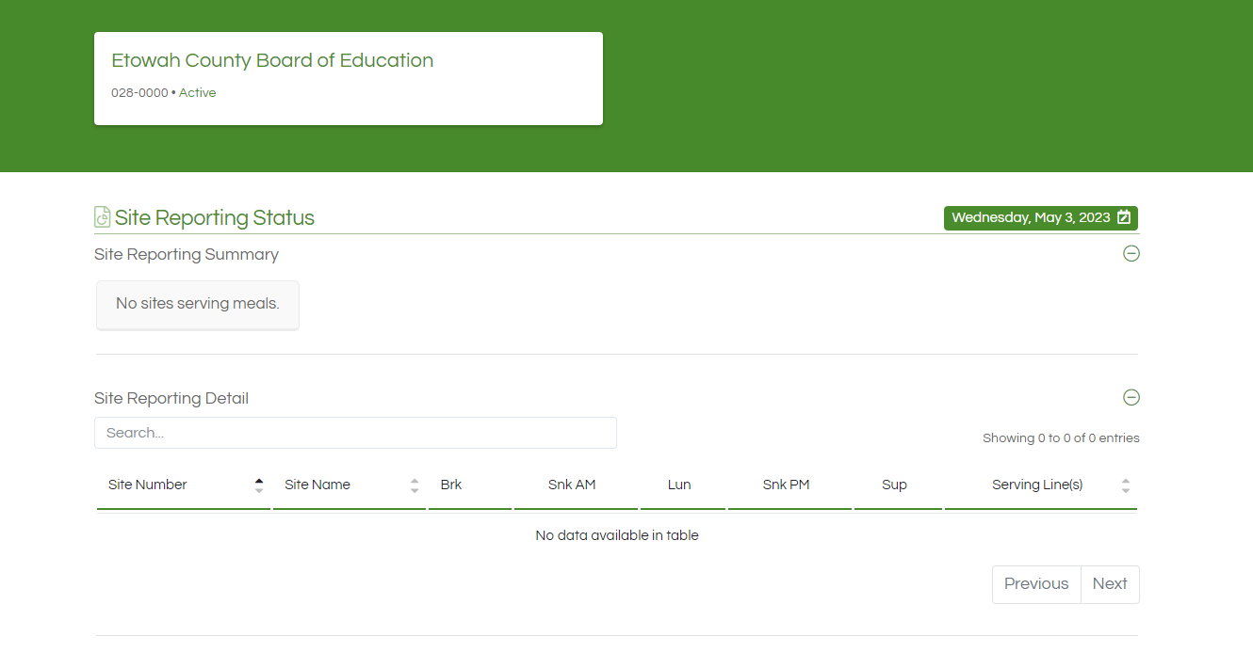

Slide 13
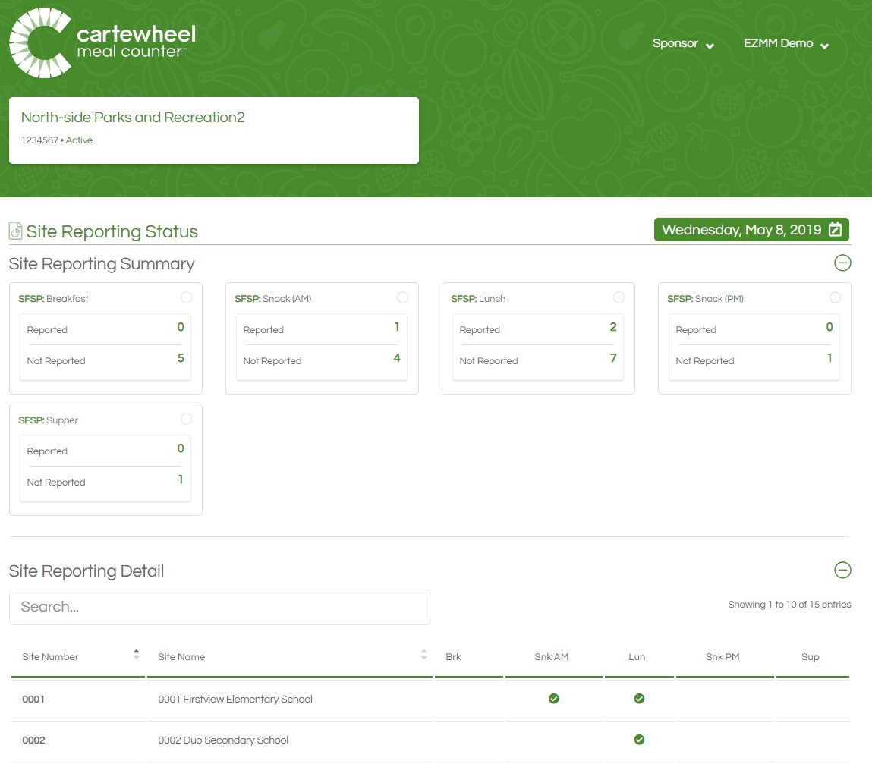
Dashboard
When you first log in to Cartewheel Meal Counter, the Site Reporting Status page displays, which functions as your dashboard to view daily site activity.
This page allows you to easily determine which sites are serving which meals ‘today’, and which sites have completed reporting those meals.
This page has two sections, a Site Reporting Summary, and Site Reporting Detail.

Slide 14
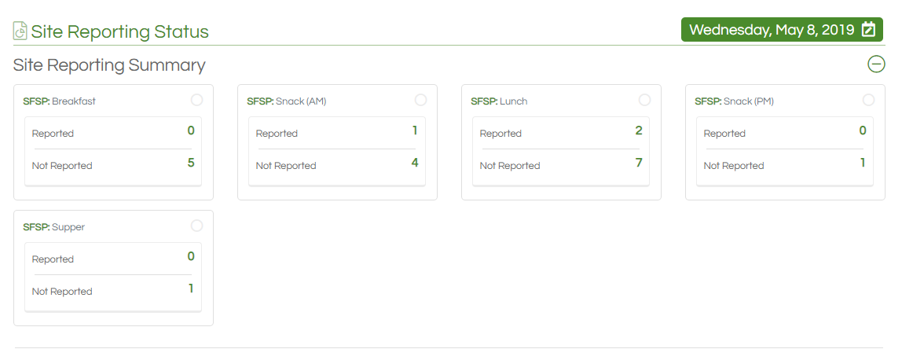
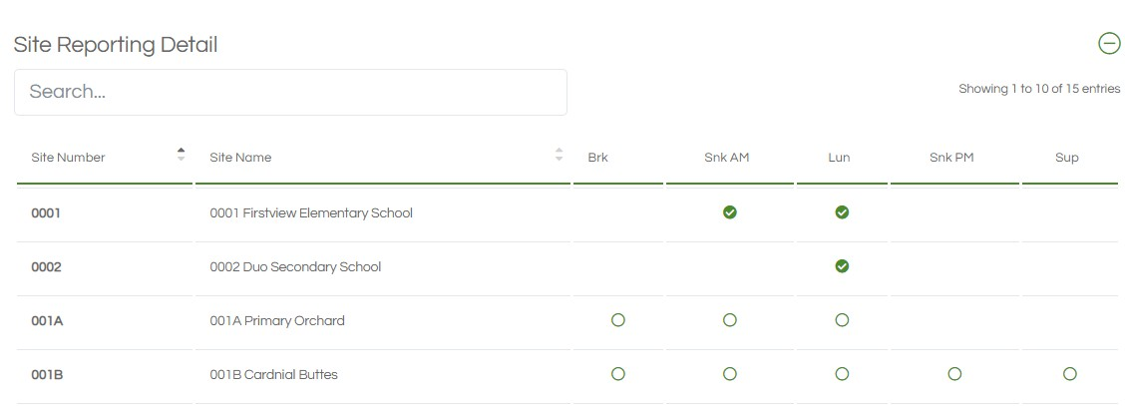
Dashboard Sections
The Summary aggregates Reporting status (Reported or Not Reported) data for all your sites by meal type served (Breakfast, AM Snack, Lunch, PM Snack, Supper).
Below the Summary, Site Reporting Detail breaks down the Summary numbers by each site.

Slide 15
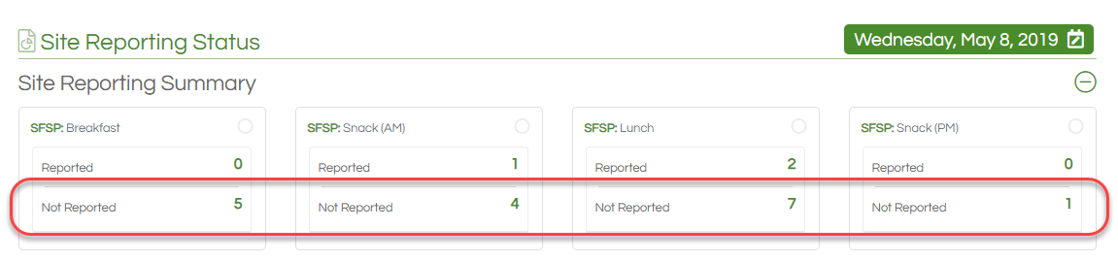
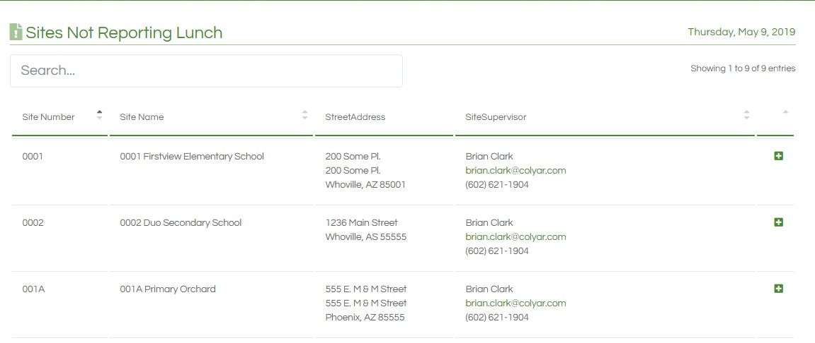
Site Reporting Summary & Not Reported List
Sponsors can easily view a list of sites that have not submitted meal counts.
Simply click on the numerical link under the ‘Not Reported’ heading in the Site Reporting Summary to see an up-to-date list of sites with outstanding meal counts.
The site supervisor's contact information is included for convenience.

Slide 16
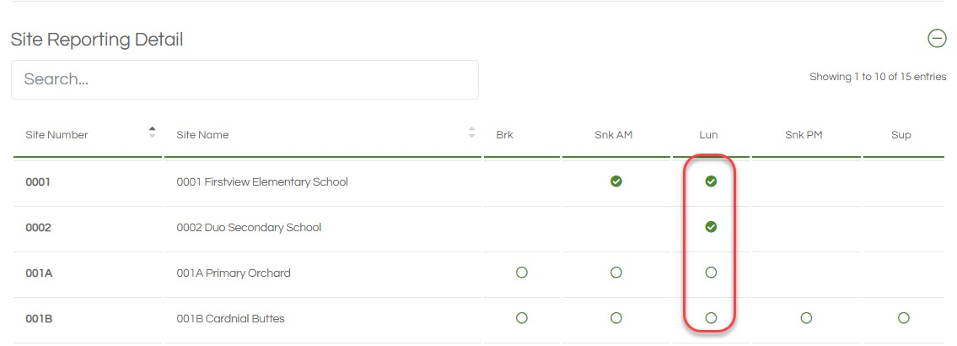
Site Reporting Detail Section
In the Site Reporting Detail section of the Dashboard, sponsors can also add or edit meal counts by clicking the circle next to the corresponding site and meal they would like to edit.
Meal counts can also be counted or edited on mobile and tablet devices.

Slide 17
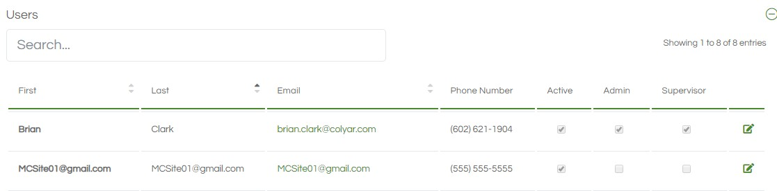
Add/Edit Sponsor Users
Sponsor User status is also visible from the Sponsor Manager page.
User information and permissions may be updated by clicking the edit icon.

Slide 18




Slide 19
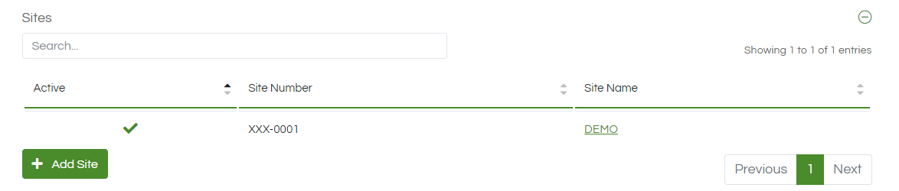
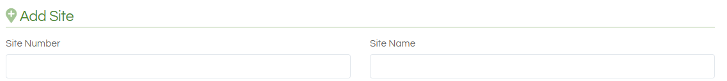

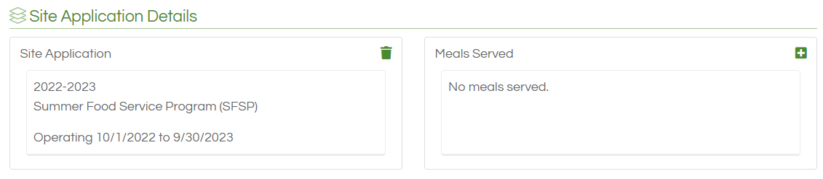
Adding Sites
Adding Meals
Access the Sponsor Manager section on the Dashboard
Select the tab the reads “Add Site”
Insert the information for the new site
Click “Add”
From the Sponsor Manager page, click the name of the site.
Select the “Eye” icon
Click the plus sign for “Meals Served”

Slide 20
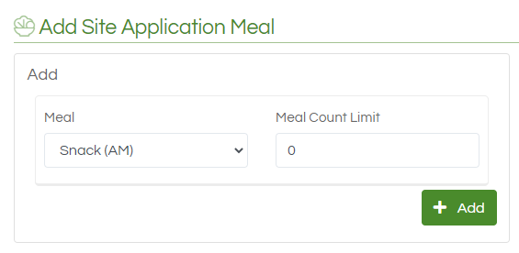
Adding Meals Continued…..
Complete the following:
-Meal
-Meal Count Limit
Click “Add”
*Repeat this process for each meal service.

Slide 21
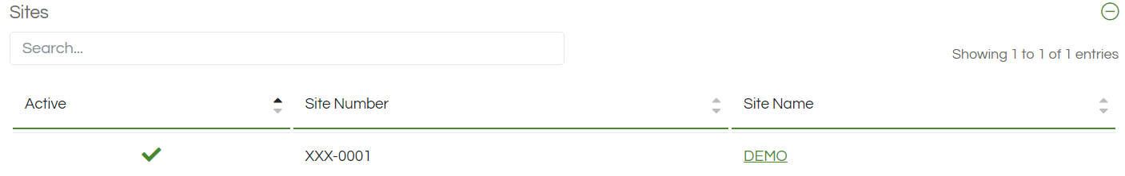
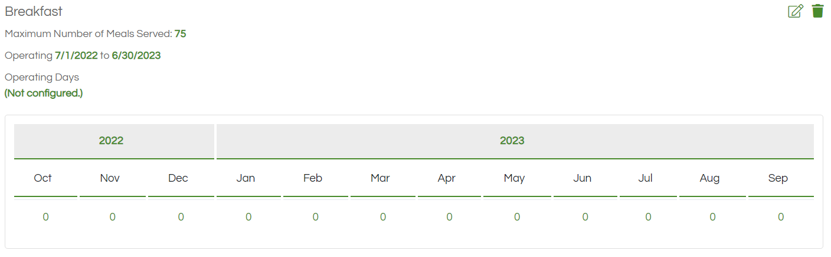
Adding Calendar Dates
From the Sponsor Manager page, select the site for the dates to be added.
Click the “Eye” icon
*Click the “0” under the month to add dates.

Slide 22
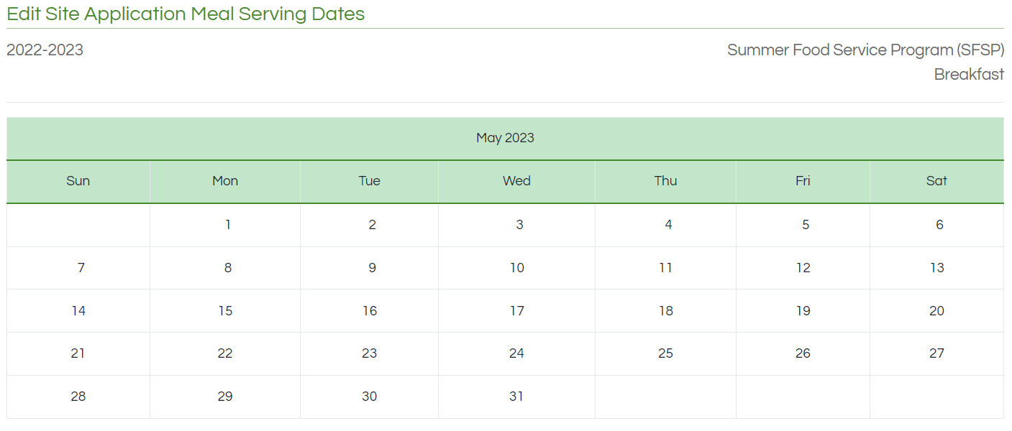
Click inside the calendar boxes to add the requested calendar dates.
Select the “Save” tab.
Repeat this process for each month and meal service.

Slide 23
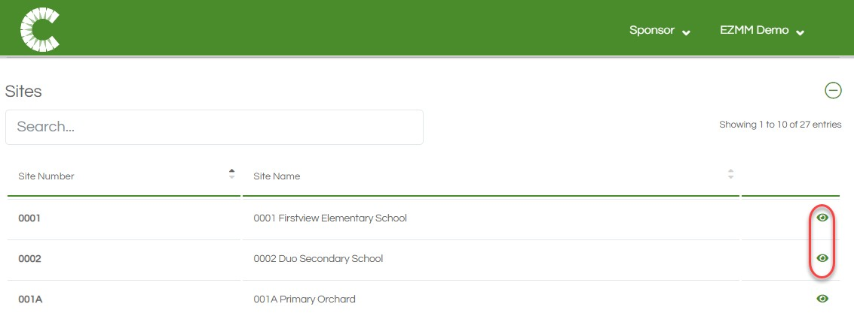
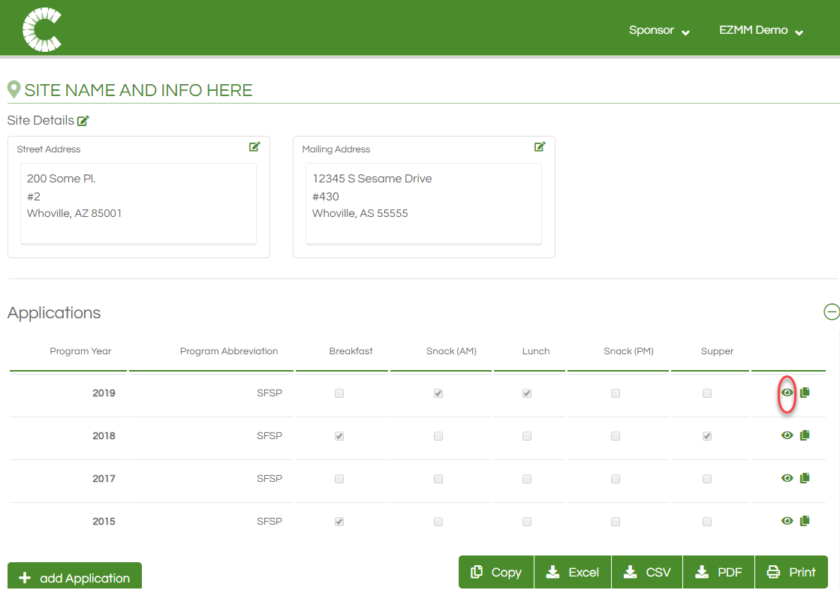

View Site Details
Site Details can be viewed by clicking the ‘Eye’ icon next to the desired site. The Site Details page includes options for editing the site information and adding Applications, which indicate which meals will be offered and for which program year.
Application details can be viewed by clicking the
‘Eye’ icon.

Slide 24
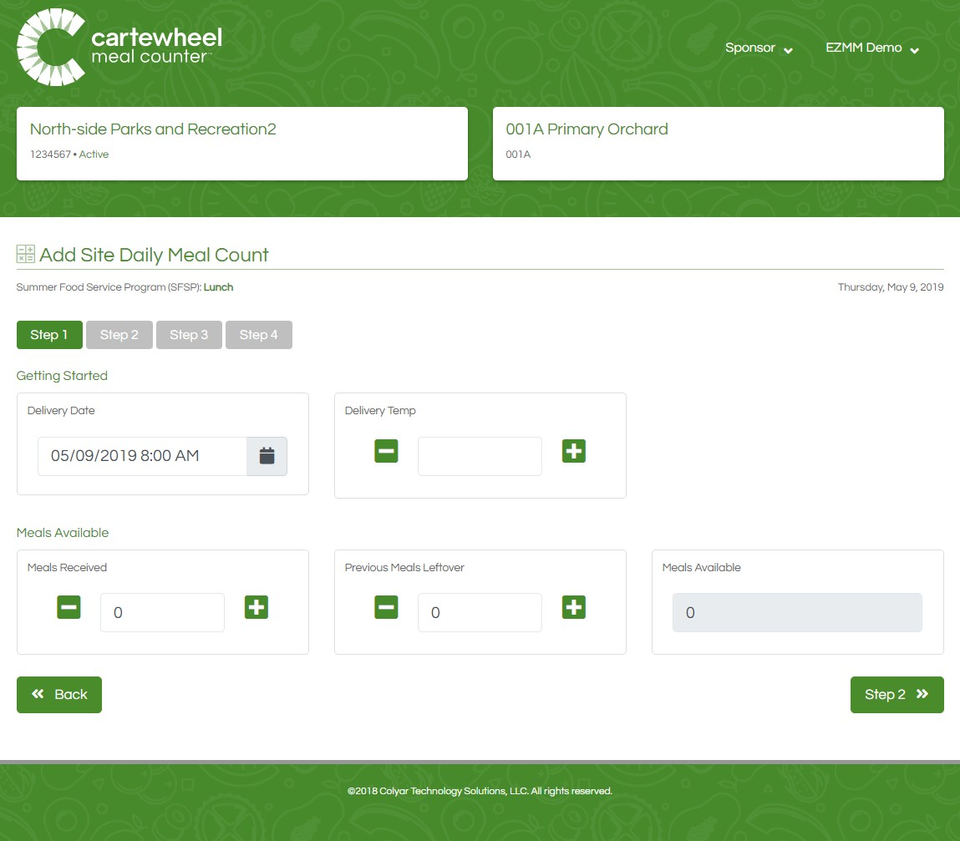
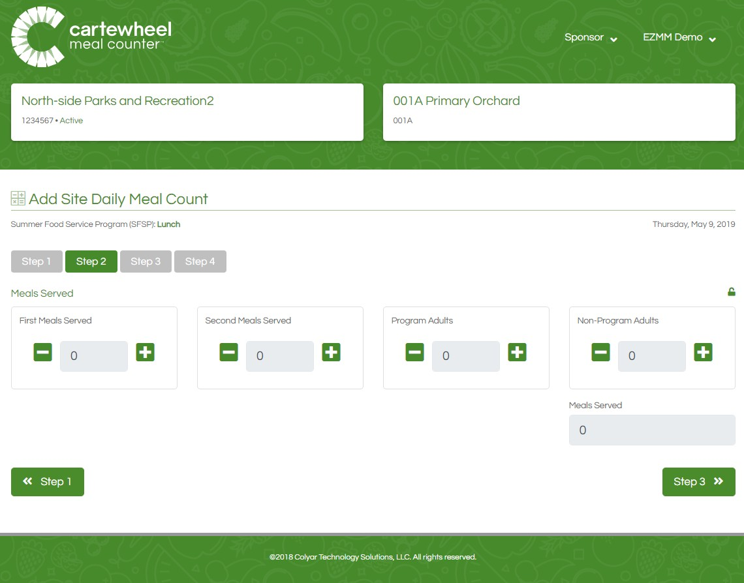
Add or Edit Meal Counts – Steps 1 & 2
Step 1. Input Delivery Data & Leftover Meals
Step 2 Count Meals Distributed by USDA Type

Slide 25
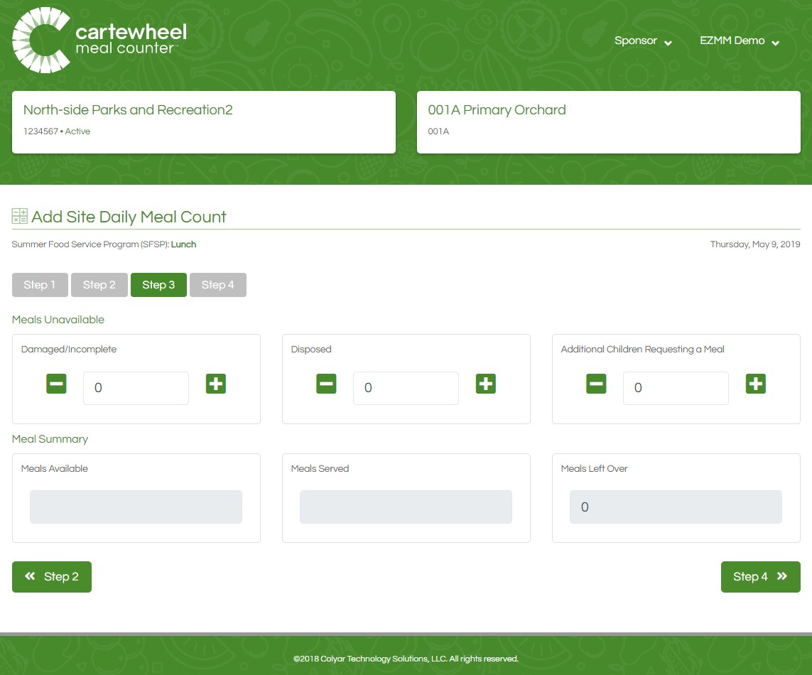
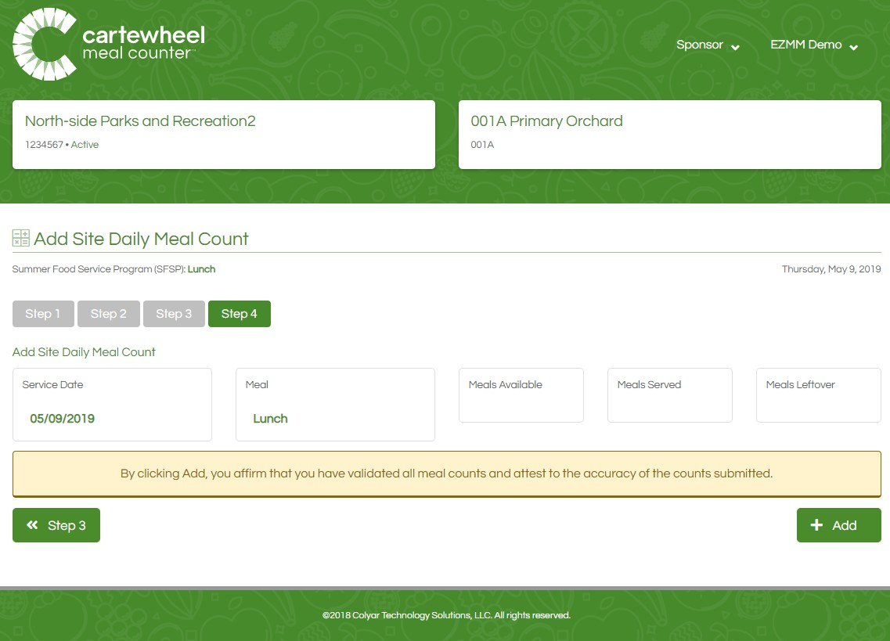
Add or Edit Meal Counts – Steps 3 & 4
Step 4 Review & Submit
Step 3. Add Damaged & Disposed Counts

Slide 26
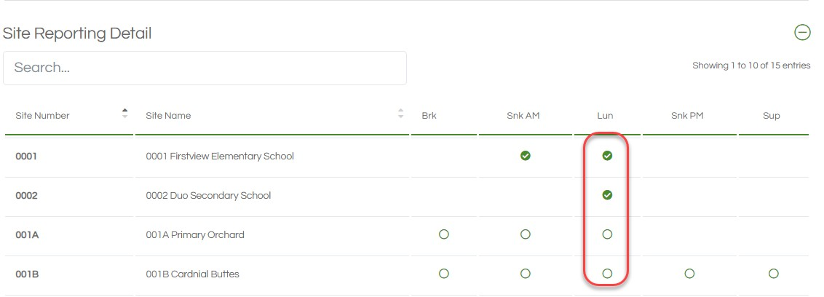
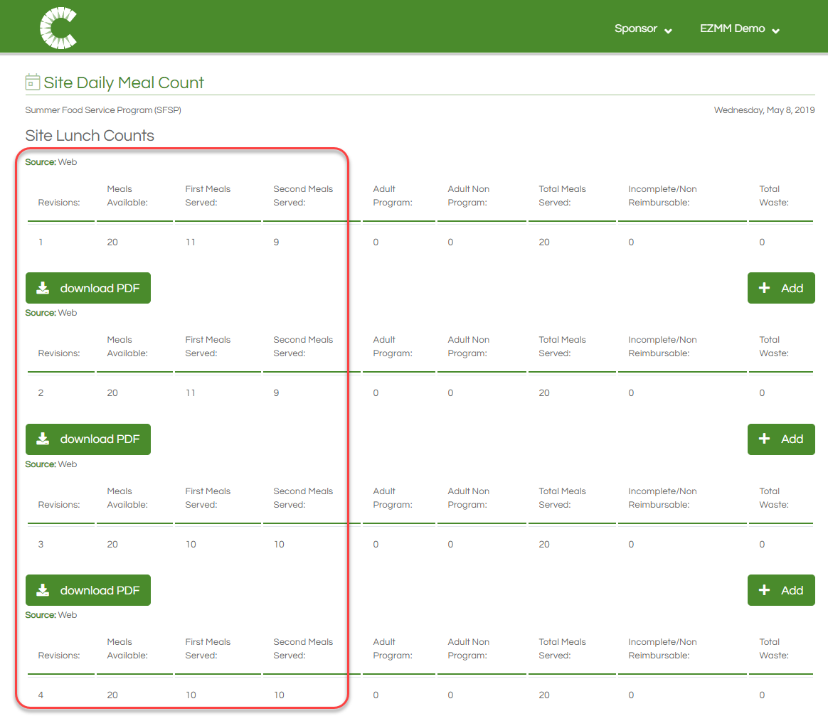
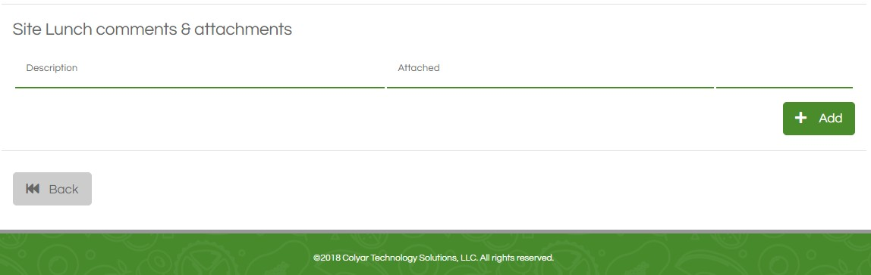
Submitted Meal Counts
Meal counts can be reviewed by selecting the filled-in circle next to the corresponding meal.
Cartewheel Meal Counter logs every meal count revision, detailing the changes along with the revision number and source device.
Documents may be included with meal counts in the Attachments section below.

Slide 27
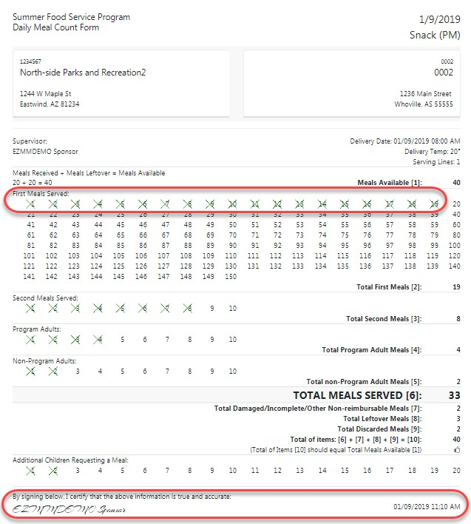
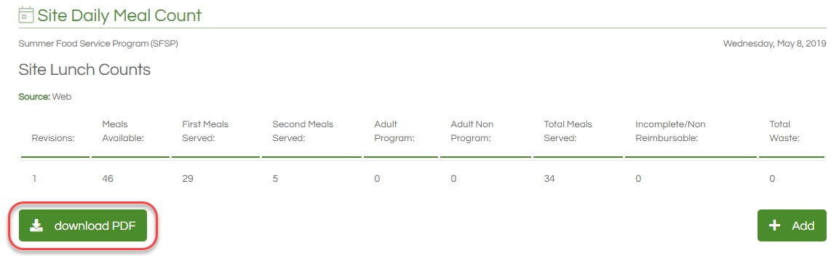
Digital SFSP Forms
Digital versions of the Daily Meal Count Form are automatically created and archived. These forms may be downloaded and printed, simply click the download pdf icon.
Digital forms are clearly completed and the authenticated e-signature is date and time stamped to help bolster program integrity.

Slide 28
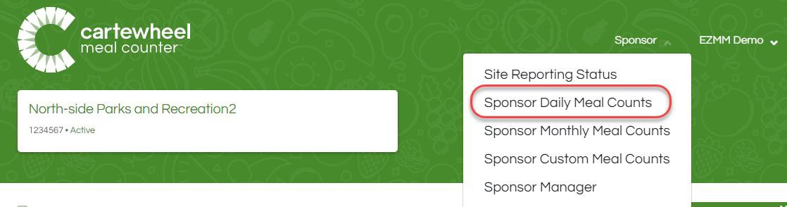
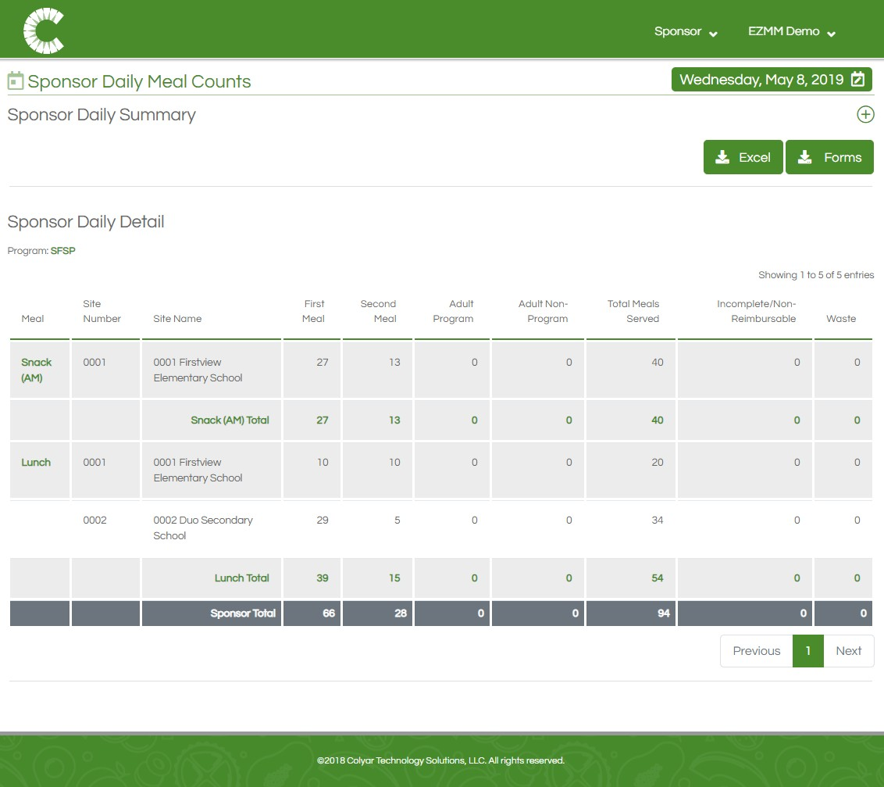
Sponsor Daily Meal Count Reports
Sponsors can view Daily Meal Count reports by clicking the link in the Sponsor drop-down menu which is located at the top left of the screen.

Slide 29
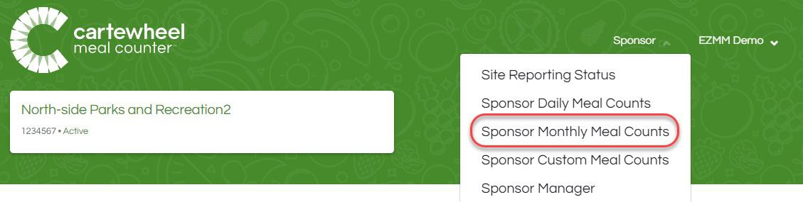
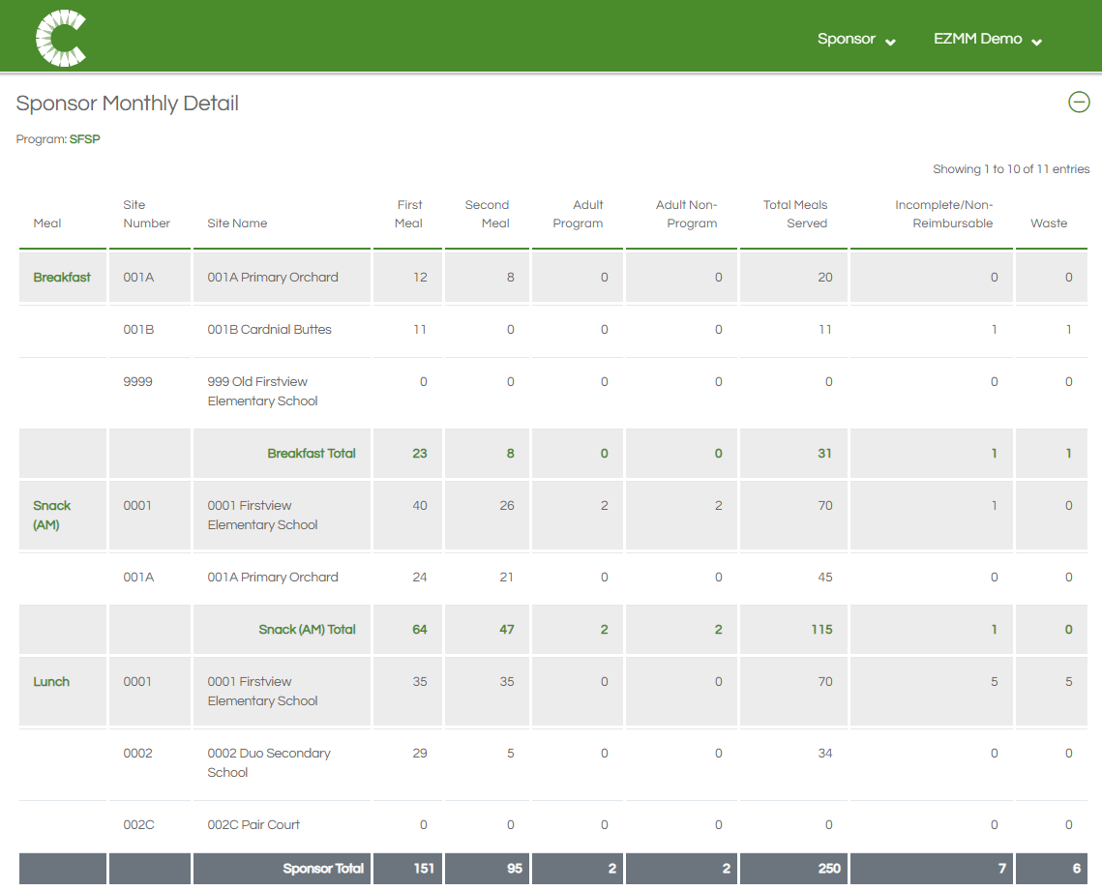
Sponsor Monthly Meal Count Reports
Sponsors can view Monthly Meal Count Reports by clicking the link in the Sponsors drop-down menu which is located at the top left of the screen.

Slide 30
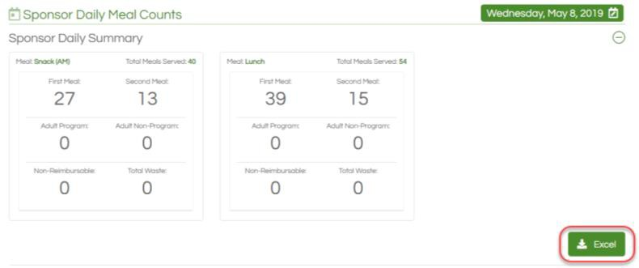
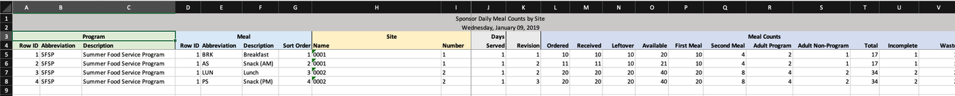
Daily Report Export
Daily reports can be exported to an XML format, viewable in Excel, by clicking the Excel icon next to Sponsor Daily Detail.

Slide 31
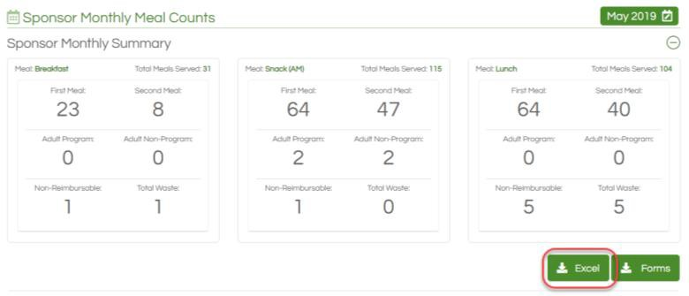
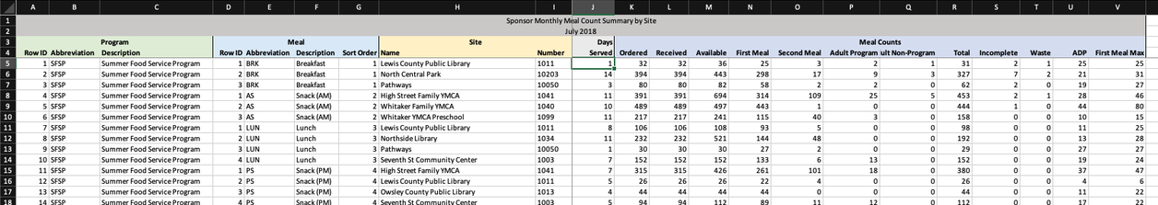
Monthly Report Export
Monthly reports can be exported to an XML format, viewable in Excel, by clicking the Excel icon next to Sponsor Monthly Detail.

Slide 32
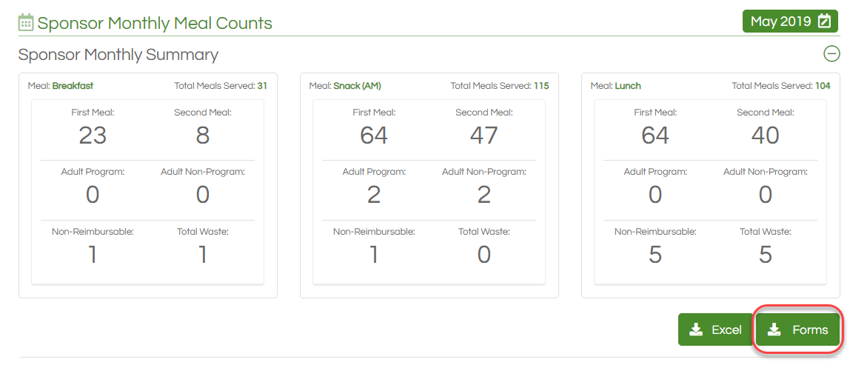
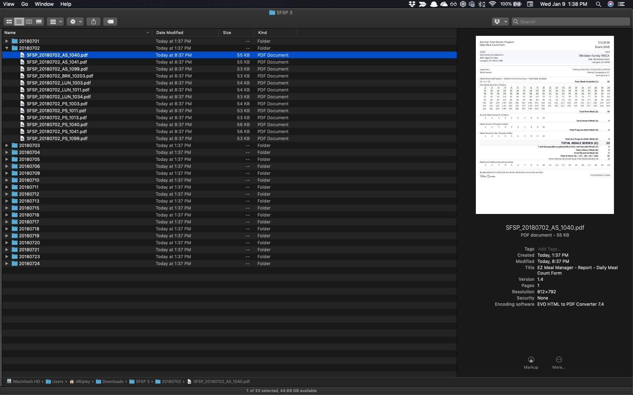
Bulk SFSP Form Archive
A Monthly archive folder containing all SFSP Forms for the month can be downloaded from the Sponsor Monthly Meal Count report.

Slide 33
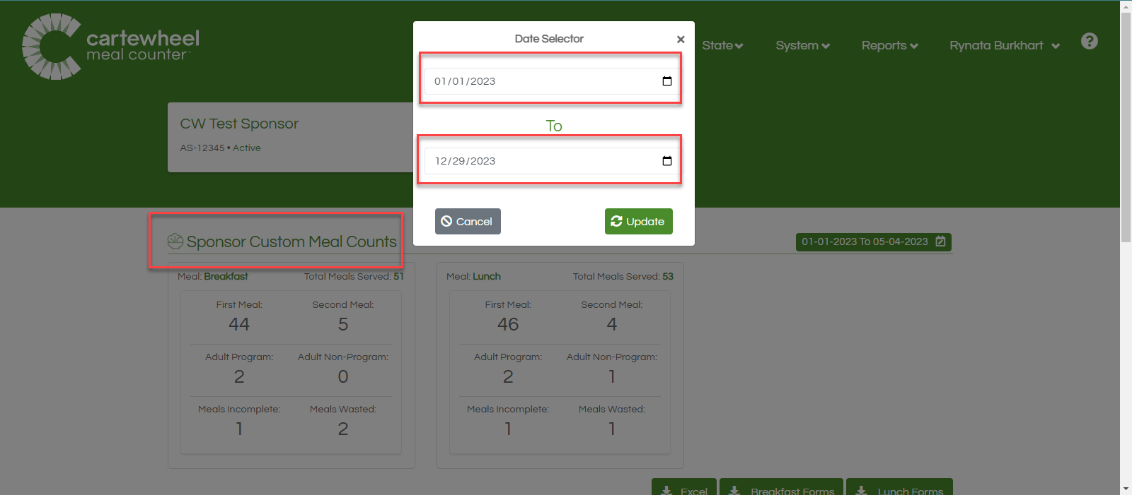
From the Sponsor tab, you can select “Custom Meal Counts” to select information from different time periods.

Slide 34
This page will lead you to your login screen for Site Supervisors.

Slide 35
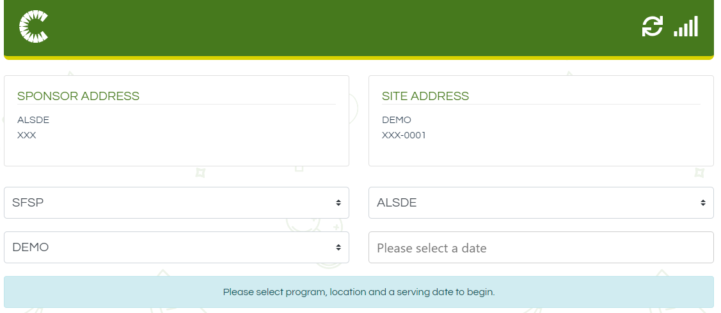

Slide 36
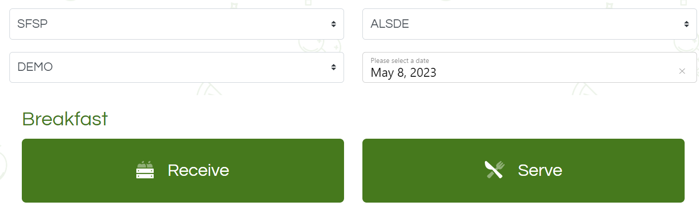
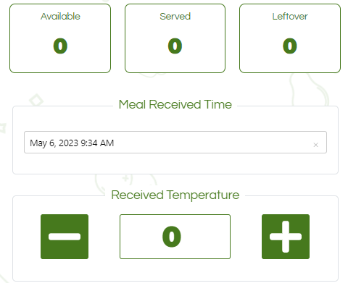
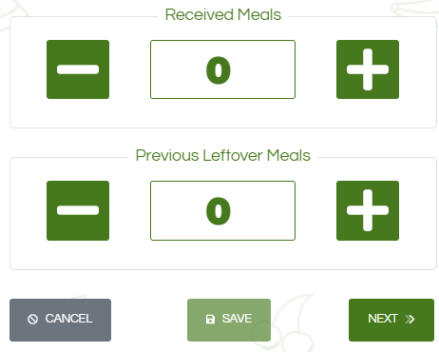
*You will need to complete the “Receive” tab before you can serve meals. Click “Save.”

Slide 37


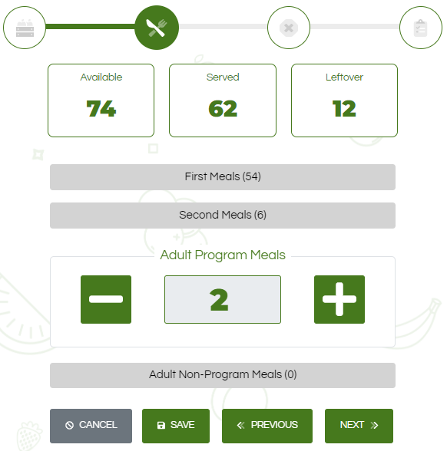
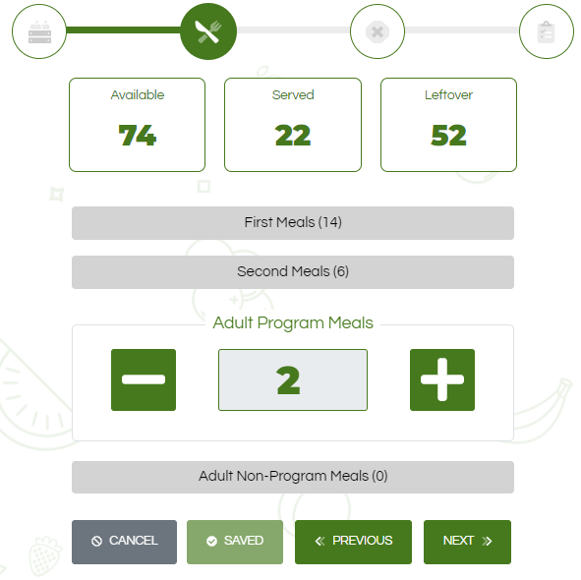
Click the to increase the count for meals served.
Click the to deduct meals.
To record “Second Meals,” select the tab and record the meals served.
*The sum of meals served is “22.”
*Click “Save.”

Slide 38


Before you can “Submit” the final meal count, you will need to verify that the meal service is accurate.
Once you click “Submit,” you will be taken back to your Dashboard.
Repeat this process for the next meal service.

Slide 39
Thank You!

