Slide 1





SFSP Claims Training
ALSDE Child Nutrition Programs (CNP)
Summer Food Service Program (SFSP)

Slide 2

Welcome!
LINQ Claims Training
Alabama SFSP Sponsors
ALSDE Child Nutrition Programs

Slide 3


Discussion Topics:
Section 1: Edit Checks
Section 2: Accessing LINQ
Section 3: Claims Entry
Section 4: Claim Rates
Section 5: Payment Summary
Section 6: Monthly Reimbursement
Summary
Section 7: Federal Awards Letter
*Click here to access the LINQ SFSP Sponsor User Manual.

Slide 4
Understanding Edit Checks
Section 1
What is an edit check?
How can we use edit checks?
Types of Edit Checks
Edit checks are review tools that can be used to ensure the effectiveness and proficiency of data collection.
To ensure all SFSP records are completed in a timely manner
To locate any errors on documents
To determine if the records align with the meal service
To review operational and administrative reports
To validate that the program operation is compliant with SFSP requirements and USDA regulations
Data Completion
-Reviewing data to ensure no information is missing
Data Verification
-Reviewing data to ensure the information is accurately collected and completed
Data Submission
-Reviewing data to ensure the records align with the report and no typos are present
ALSDE Child Nutrition Programs

Slide 5
The Value of Edit Checks
Section 1
Completion
Accuracy
Reasonable
Quality
Integrity
Validity
ALSDE Child Nutrition Programs

Slide 6
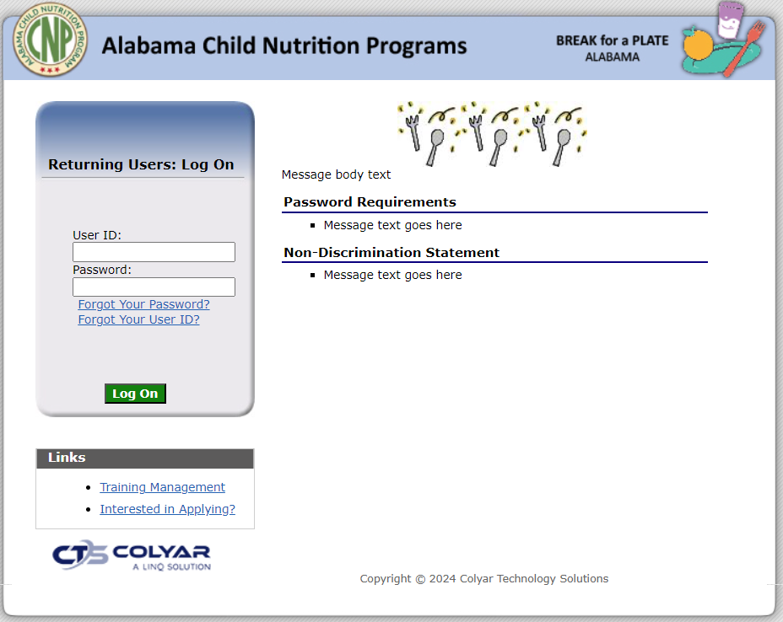
Section 1
Section 2
The following SFSP records should be used for the claims process:
-Meal Counts
-Attendance Records
-Financial Records
Accessing LINQ
Insert login information and select “Log On.”
ALSDE Child Nutrition Programs
LINQ SFSP Sponsor Manual: Section 3, page 10

Slide 7
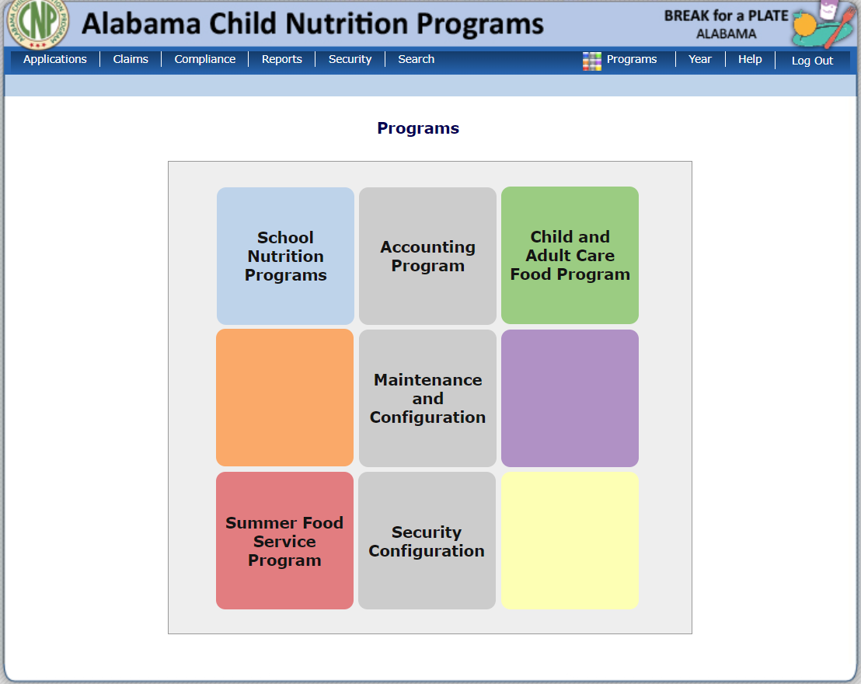
Section 2
Programs Page
The program tiles are available based upon a sponsor’s approved CN programs.
The sponsor will select the Summer Food Service Program.
If a sponsor is only enrolled in a single program, this Programs page will not display. Instead, the user is taken directly to the SFSP Splash page.
ALSDE Child Nutrition Programs
LINQ SFSP Sponsor Manual: Section 3, page 11

Slide 8

Section 2
Section 1
Splash
Page
The Splash page displays general information and announcements posted by the ALSDE CNP.
The sponsor can utilize the header menu links to navigate the system.
ALSDE Child Nutrition Programs
LINQ SFSP Sponsor Manual: Section 3, page 11

Slide 9
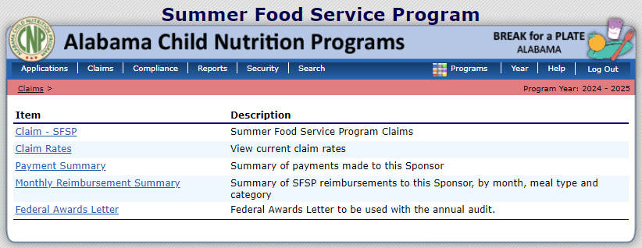
Section 2
Section 1
Accessing the Claims Menu
This page is broken down into two categories: Item and Description.
What sponsors can view depends on the participating programs and security permissions.
Click “Claim – SFSP” to begin.
ALSDE Child Nutrition Programs
LINQ SFSP Sponsor Manual: Section 6, page 45

Slide 10
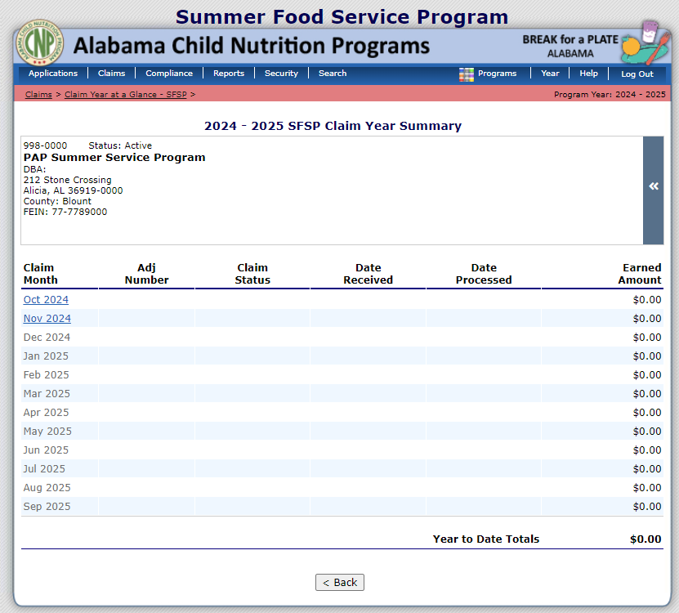
Section 3
Section 1
Make sure the right program year is selected.
The Claim Year Summary page has six columns for monitoring and tracking.
The month/year is hyperlinked if information can be inserted.
Select the month/year for the reimbursement claim.
Claim Entry
ALSDE Child Nutrition Programs
LINQ SFSP Sponsor Manual: Section 6, page 49

Slide 11
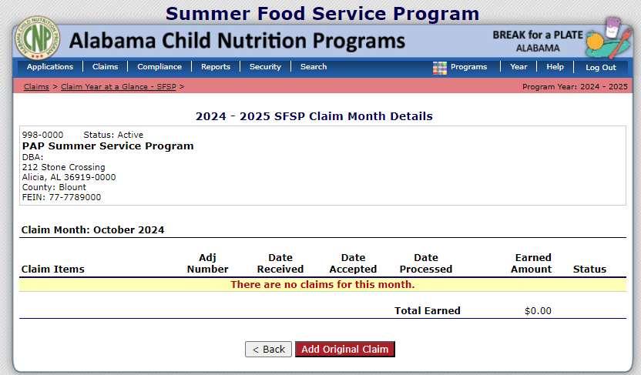
Section 3
Section 1
Claim Entry
Verify that the correct claim month is identified under the sponsor’s information.
Select “Add Original Claim” to begin inserting information for the site.
ALSDE Child Nutrition Programs
LINQ SFSP Sponsor Manual: Section 6, page 49

Slide 12
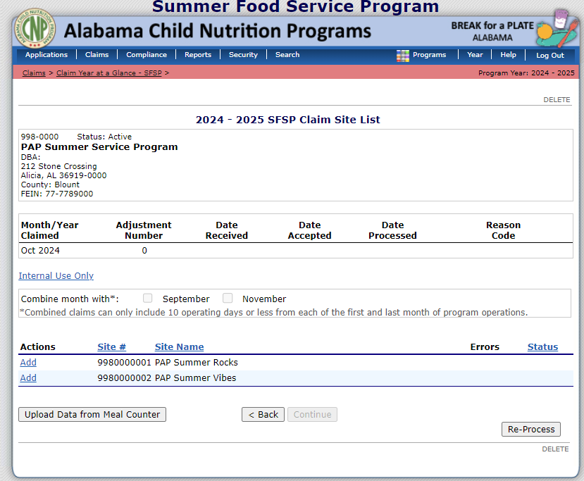
Section 3
Section 1
The Claim Site List is displayed here.
Find the site, if there are multiple in the organization.
Click “Add” by the site to insert claim data.
If any approved sites are not listed, please contact the ALSDE.
Claim Entry
ALSDE Child Nutrition Programs
LINQ SFSP Sponsor Manual: Section 6, page 49

Slide 13
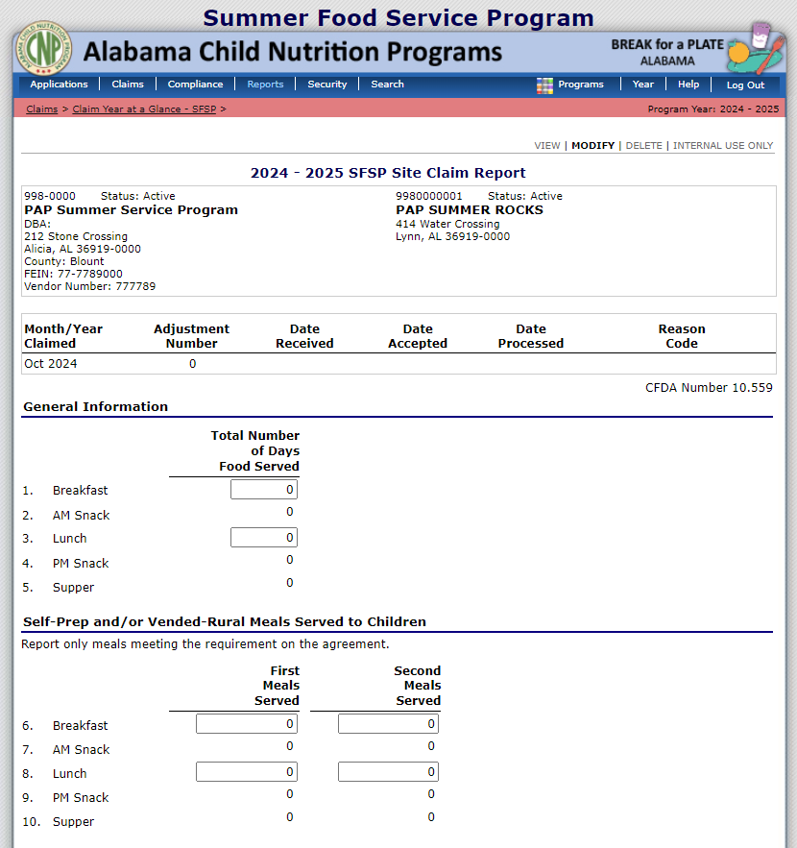
Section 3
Section 1
Use the SFSP records to insert data into the claim.
Claim Entry
ALSDE Child Nutrition Programs

Slide 14
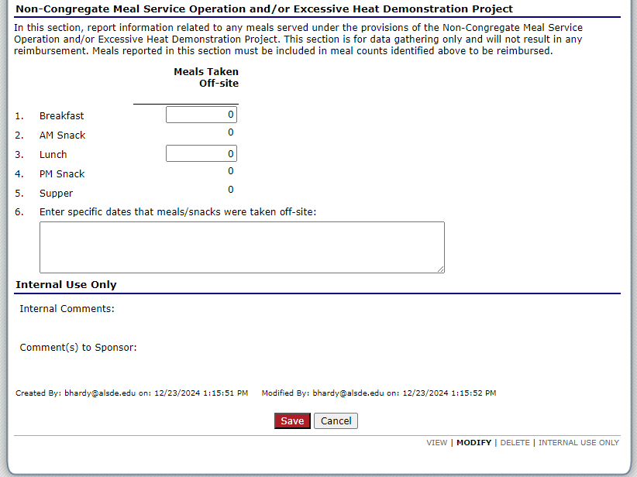
Section 3
Section 1
Claim Entry
ALSDE Child Nutrition Programs

Slide 15
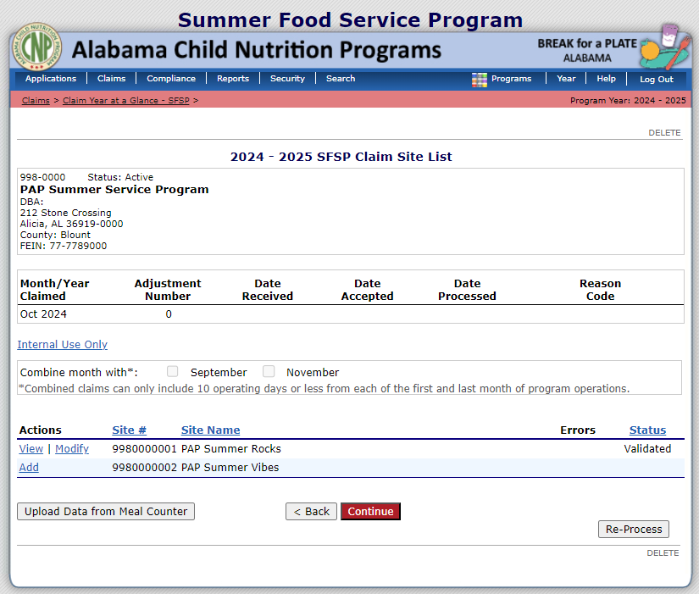
Section 3
Section 1
Claim Entry
ALSDE Child Nutrition Programs
LINQ SFSP Sponsor Manual: Section 6, page 50

Slide 16
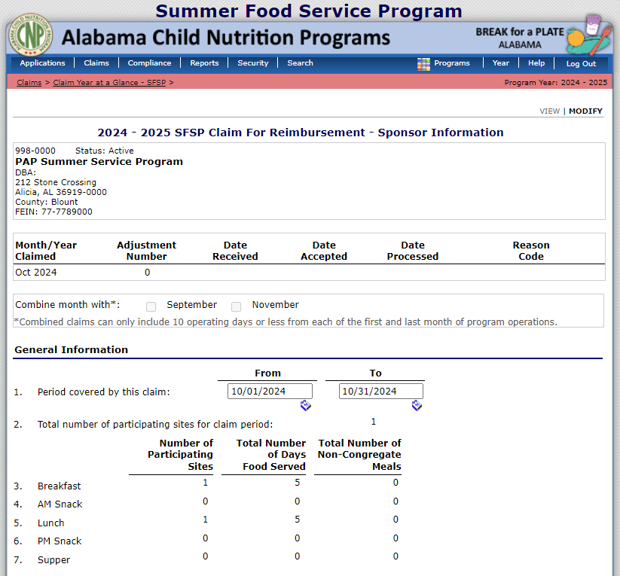
Section 3
Section 1
Claim Entry
ALSDE Child Nutrition Programs

Slide 17
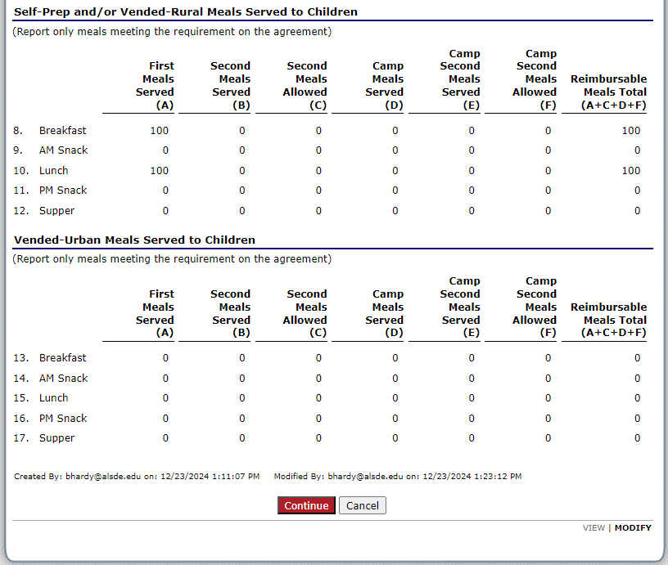
Section 3
Section 1
Claim Entry
ALSDE Child Nutrition Programs
LINQ SFSP Sponsor Manual: Section 6, page 50

Slide 18
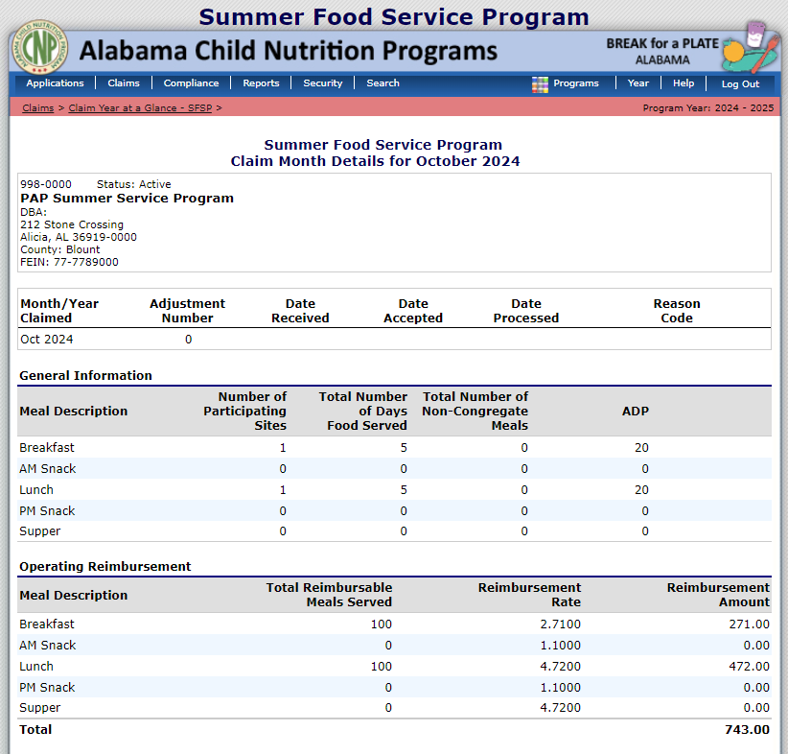
Section 3
Section 1
Claim Entry
ALSDE Child Nutrition Programs

Slide 19
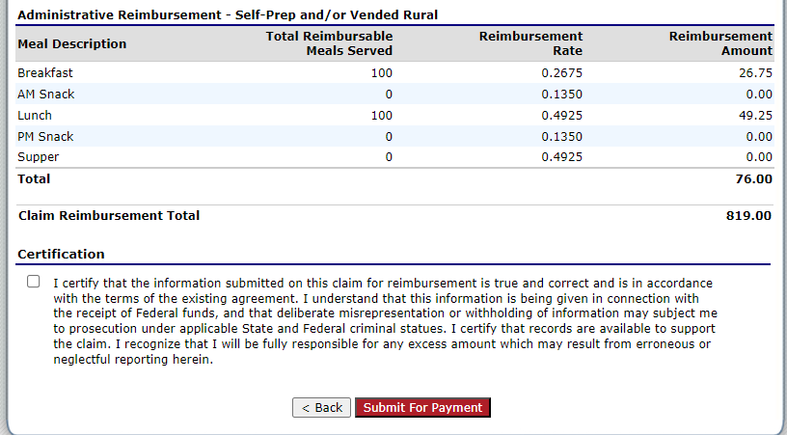
Section 3
Section 1
Submitting the Claim
ALSDE Child Nutrition Programs
LINQ SFSP Sponsor Manual: Section 6, page 50

Slide 20
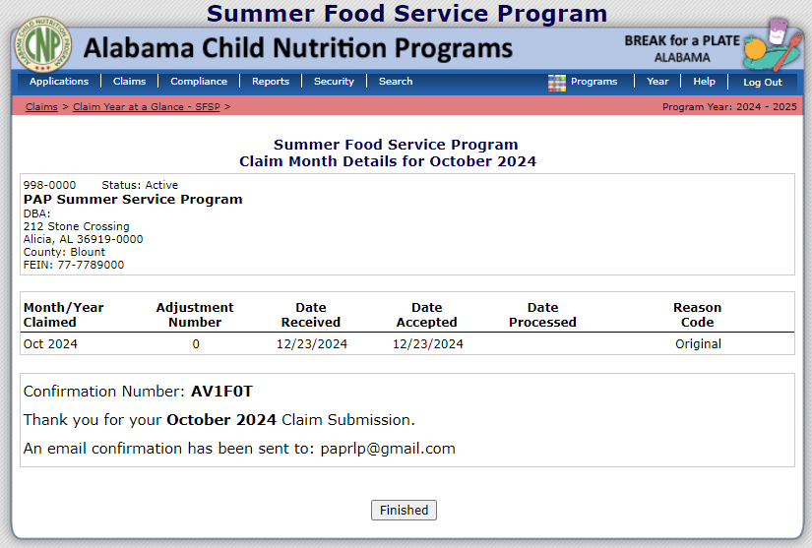
Section 3
Section 1
Submission
Confirmation
ALSDE Child Nutrition Programs

Slide 21
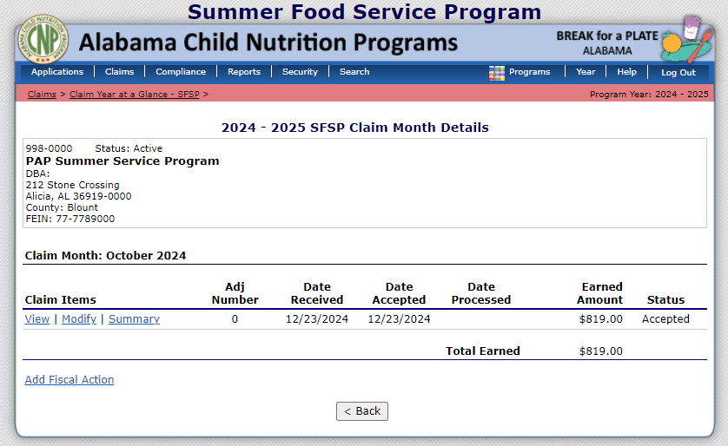
Section 3
Section 1
Claim Summary
ALSDE Child Nutrition Programs

Slide 22
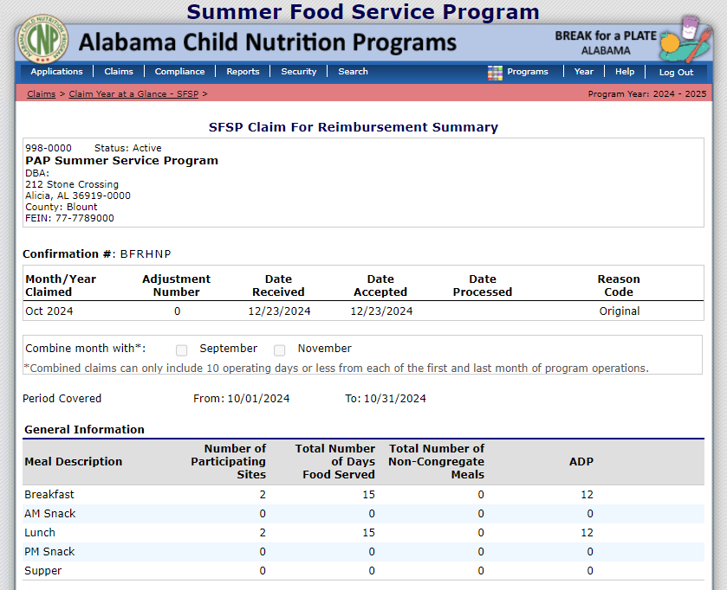
Section 3
Section 1
Claim
Reimbursement
Summary
Scroll to the bottom of the screen.
ALSDE Child Nutrition Programs

Slide 23
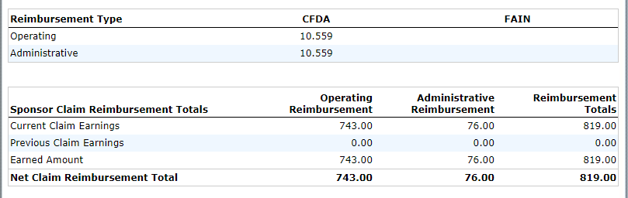

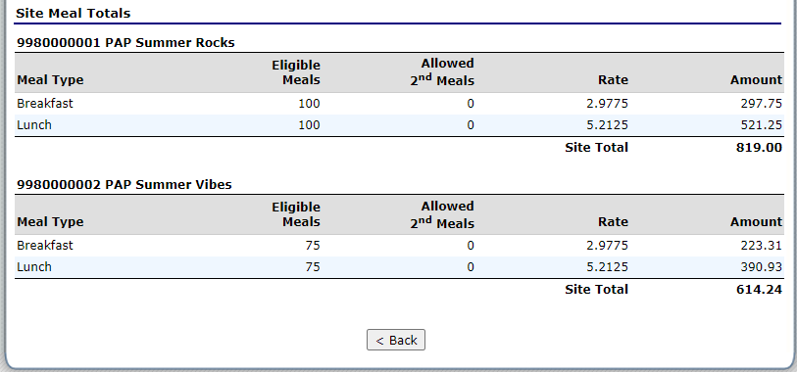
Section 3
Section 1
Click on “Claim Year at a Glance – SFSP” in the pink trail at the top of the screen to access the Claim Year Summary page.
Claim
Reimbursement
Summary
ALSDE Child Nutrition Programs

Slide 24
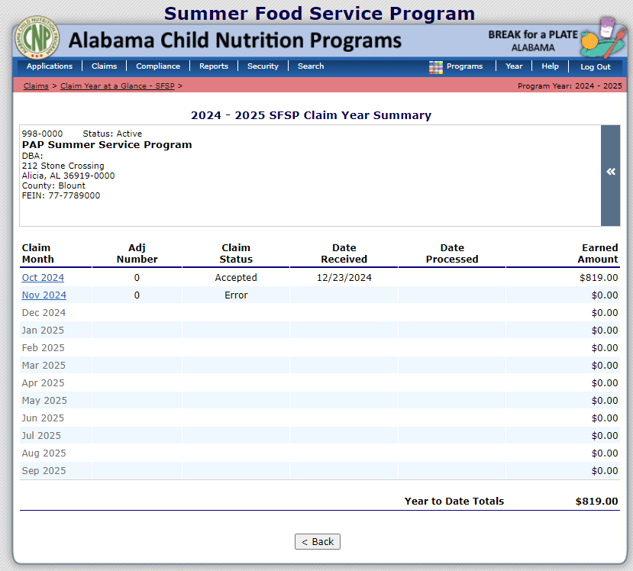
Section 3
Section 1
Errors
ALSDE Child Nutrition Programs

Slide 25
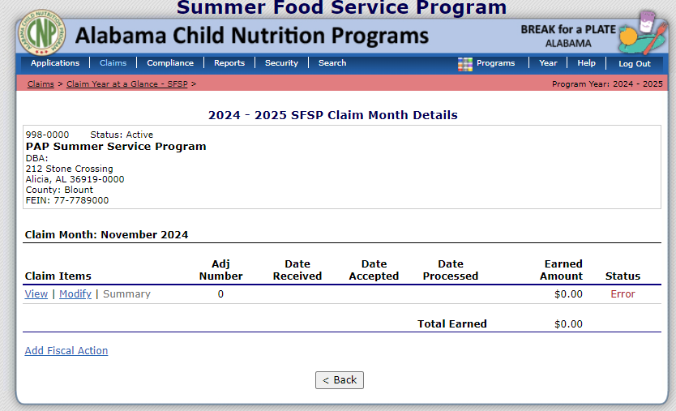
Section 3
Section 1
Errors
ALSDE Child Nutrition Programs

Slide 26
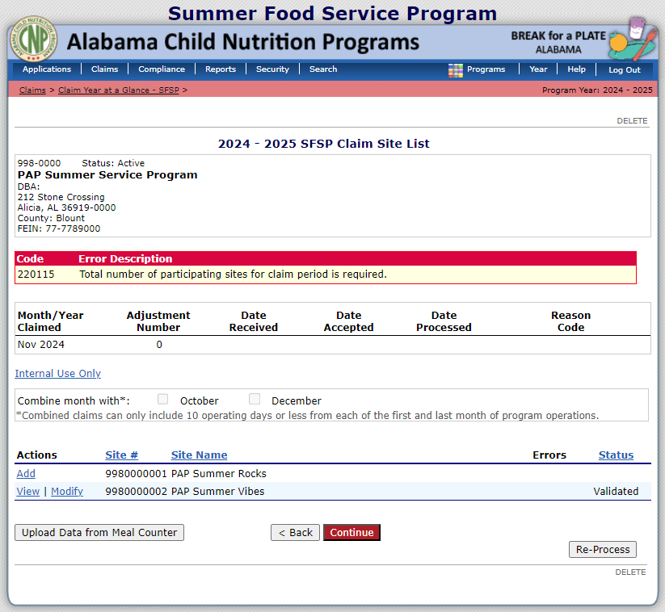
Section 3
Section 1
Claims can’t be submitted until all errors have been corrected.
Errors
ALSDE Child Nutrition Programs

Slide 27
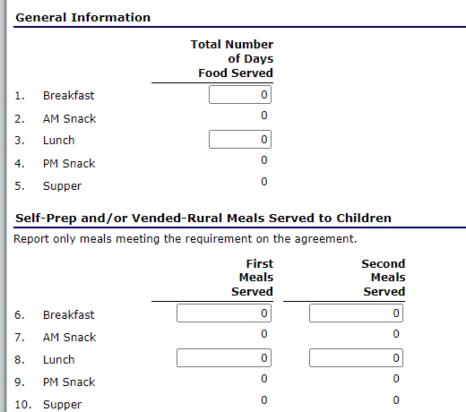
Section 3
Section 1
Information wasn’t inserted into these two sections.
Once information is inserted into the sections, the claim can be submitted for approval.
Errors
ALSDE Child Nutrition Programs

Slide 28
Section 3
Section 1
Submission Confirmation
ALSDE Child Nutrition Programs

Slide 29
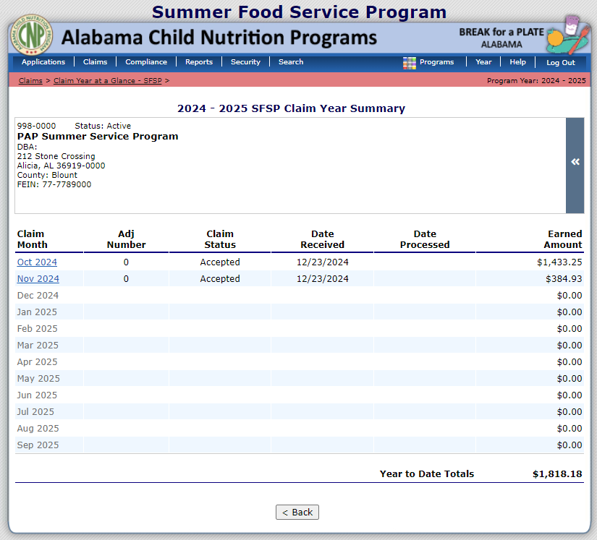
Section 4
Section 1
Summary
ALSDE Child Nutrition Programs
LINQ SFSP Sponsor Manual: Section 6, page 69

Slide 30

Section 4
Section 1
Claim Rates
ALSDE Child Nutrition Programs
LINQ SFSP Sponsor Manual: Section 6, page 56

Slide 31
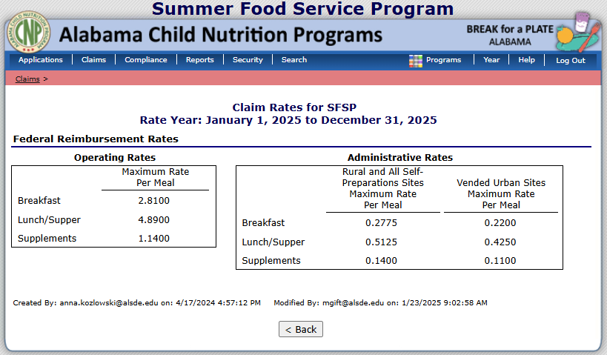
Section 4
Section 1
Claim Rates
ALSDE maintains the data inserted on this page.
Sponsors can observe this page in “View Only” mode.
ALSDE Child Nutrition Programs
LINQ SFSP Sponsor Manual: Section 6, page 56

Slide 32
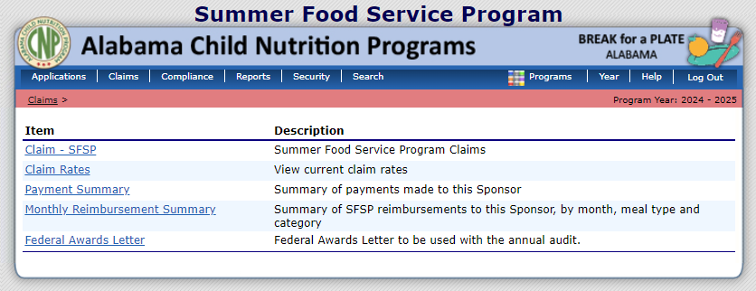
Section 5
Section 1
Payment Summary
ALSDE Child Nutrition Programs
LINQ SFSP Sponsor Manual: Section 6, page 57

Slide 33
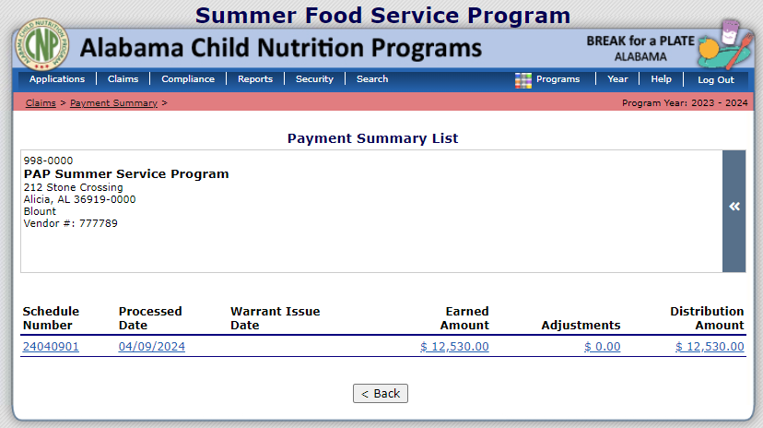
Section 5
Section 1
Payment Summary
This information is only available once the claim has been accepted and processed by the ALSDE.
For demonstration purposes only, a prior fiscal year was selected to provide additional information for this section of the presentation.
ALSDE Child Nutrition Programs
LINQ SFSP Sponsor Manual: Section 6, page 57

Slide 34
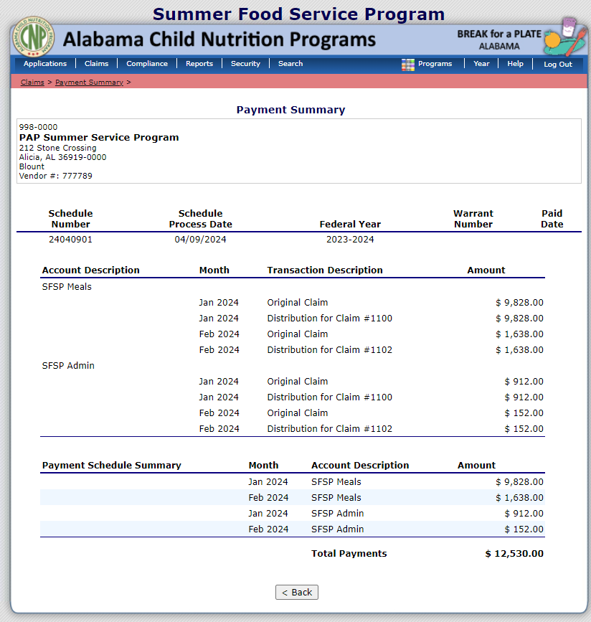
Section 5
Section 1
Payment Summary
ALSDE Child Nutrition Programs
LINQ SFSP Sponsor Manual: Section 6, page 57

Slide 35
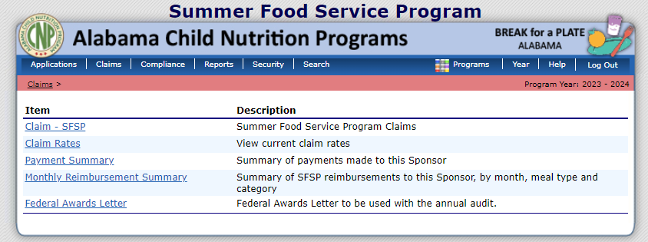
Section 6
Section 1
Monthly Reimbursement Summary
ALSDE Child Nutrition Programs
LINQ SFSP Sponsor Manual: Section 6, page 57

Slide 36
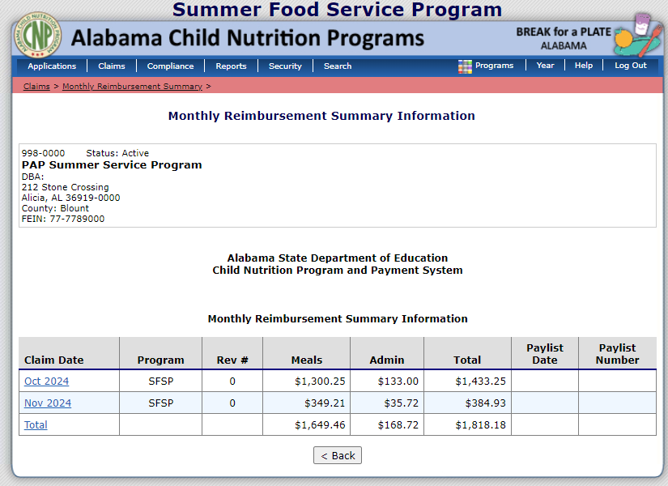
Section 6
Section 1
Monthly Reimbursement Summary
ALSDE Child Nutrition Programs
LINQ SFSP Sponsor Manual: Section 6, page 57

Slide 37

Section 6
Section 1
Monthly Reimbursement Summary
Scroll to the bottom of the screen.
ALSDE Child Nutrition Programs
LINQ SFSP Sponsor Manual: Section 6, page 57

Slide 38
Section 6
Section 1
Monthly Reimbursement Summary
ALSDE Child Nutrition Programs
LINQ SFSP Sponsor Manual: Section 6, page 57

Slide 39

Section 7
Section 1
Federal Awards
Letter
ALSDE Child Nutrition Programs
LINQ SFSP Sponsor Manual: Section 6, page 58

Slide 40
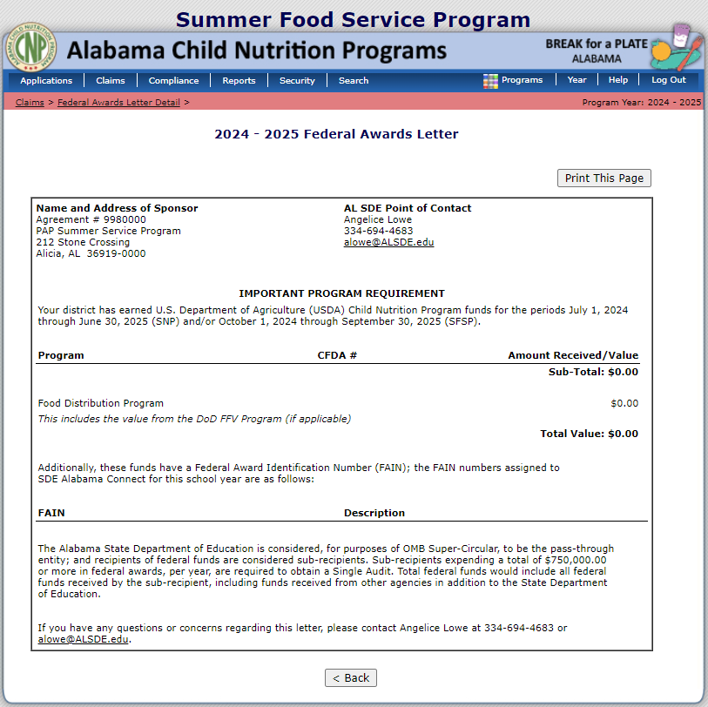
Section 7
Section 1
Federal Awards
Letter
ALSDE Child Nutrition Programs
LINQ SFSP Sponsor Manual: Section 6, page 58

Slide 41


Email: sfsp@alsde.edu Phone: (334) 694-4657

